Slide 1
CERVICAL FASCIA
DR OSO O.A

Slide 2
OUTLINE
INTRODUCTION
DEEP CERVICAL FASCIA OF THE NECK
SUBDIVISIONS
ATTACHMENT AND ORIENTATION OF THE SUBDIVISIONS
FASCIAL SPACES OF THE NECK
CLINICAL IMPORTANCE OF THE SPECIAL SPACES OF THE NECK

Slide 3
INTRODUCTION
Skin of the neck: thin, Langers line is transverse in orientation
Importance: a surgical incision parallel to these lines makes an invisible scar
Fascia: fibrous connective tissue that binds together various structures of the body.
Two types:
  Superficial, subcutaneous
  Deep fascia, surrounding muscles, organs of the neck, and blood vessels

Slide 4
INTRODUCTION
Superficial fascia: a thin lamina layer that lies between skin and deep cervical fascia, containing the platysma muscle. Contains a considerable amount of adipose tissues
Plastyma: it arises from the fascia covering pectoralis major, goes superomedially in the superficial fascia in the posterior triangle and then in the anterior triangle to the lower border of the mandible.

Slide 5
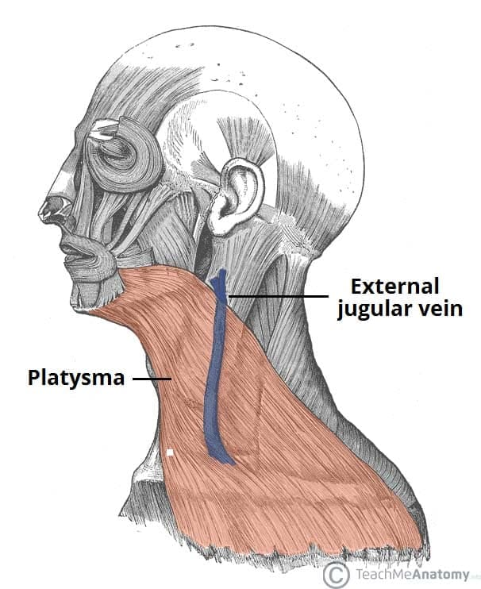
INTRODUCTION
Nerve supply: cervical branch of the facial nerve
Action: releases pressure of skin over underlying veins and helps in venous return
Injury: severe venous bleeding

Slide 6
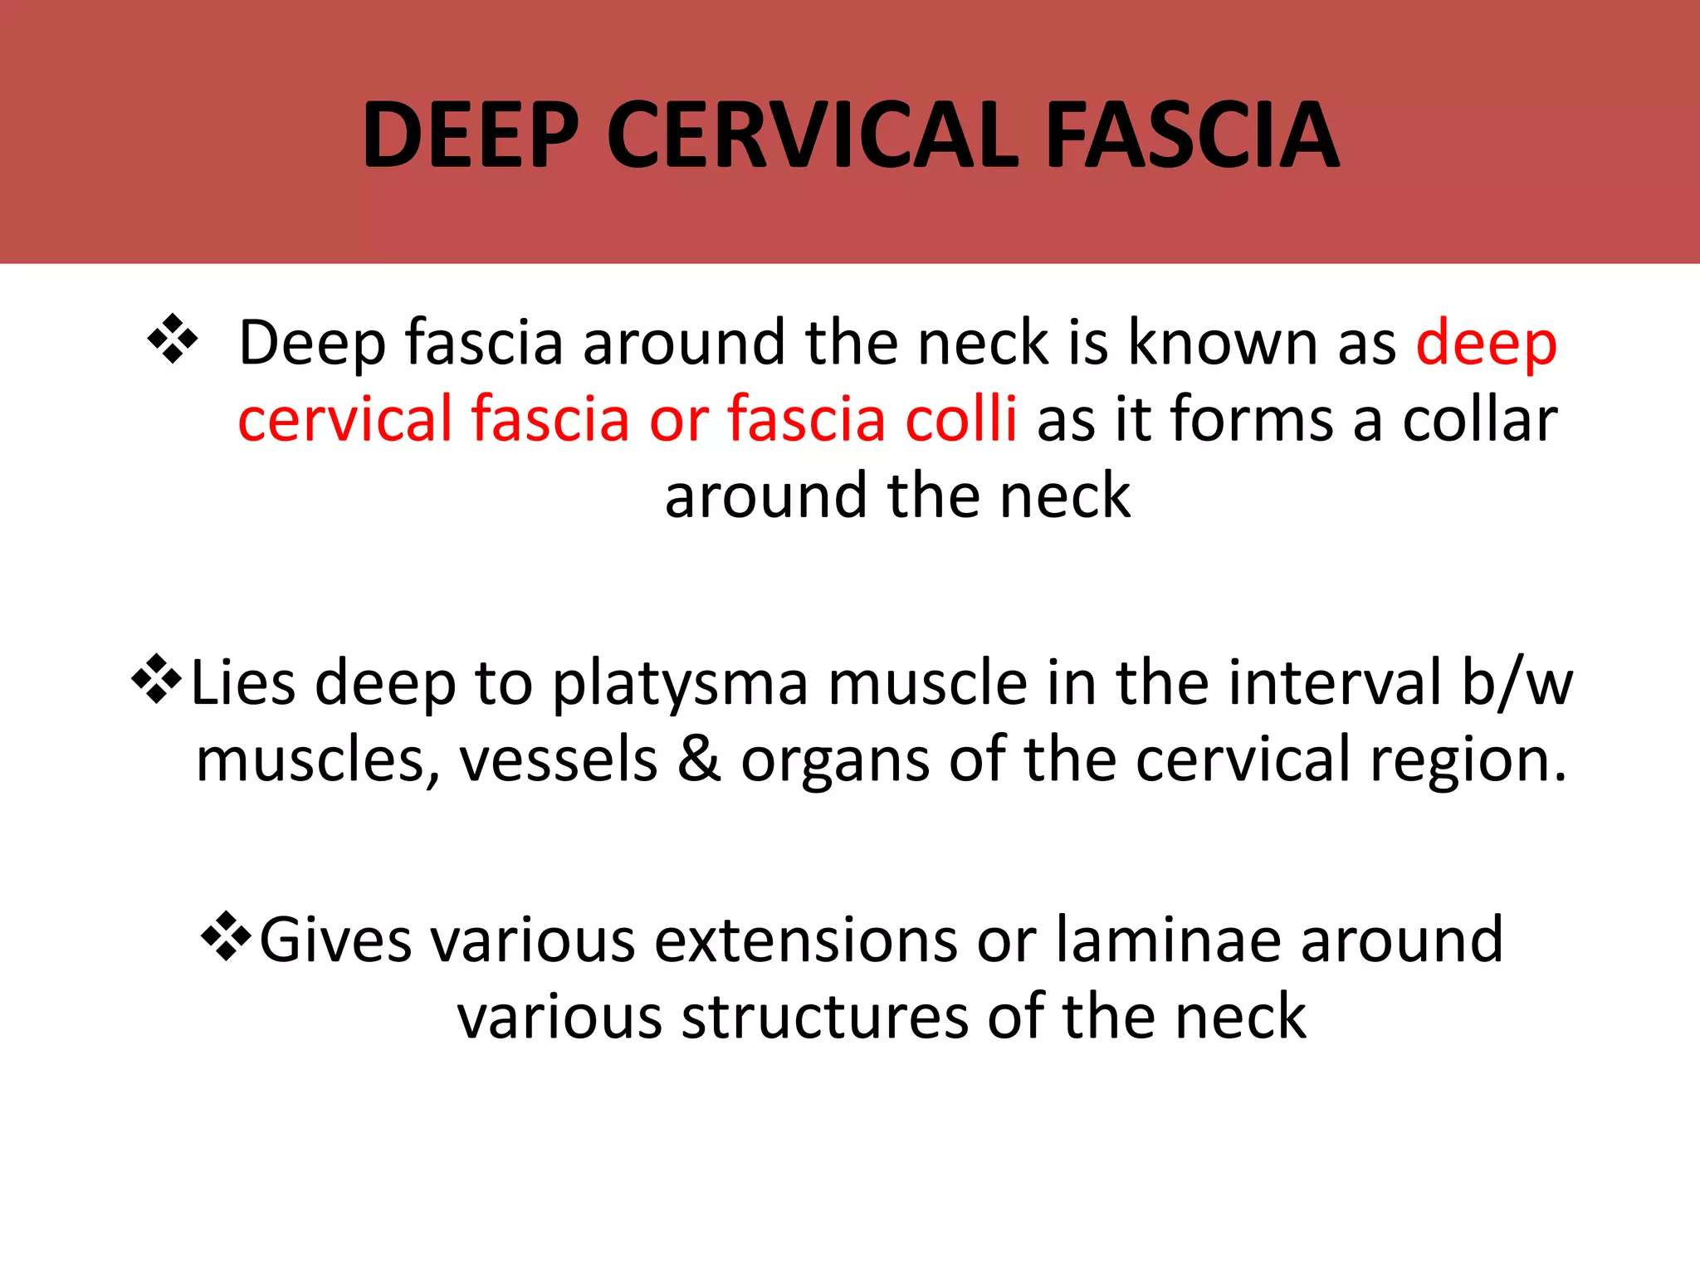

Slide 7
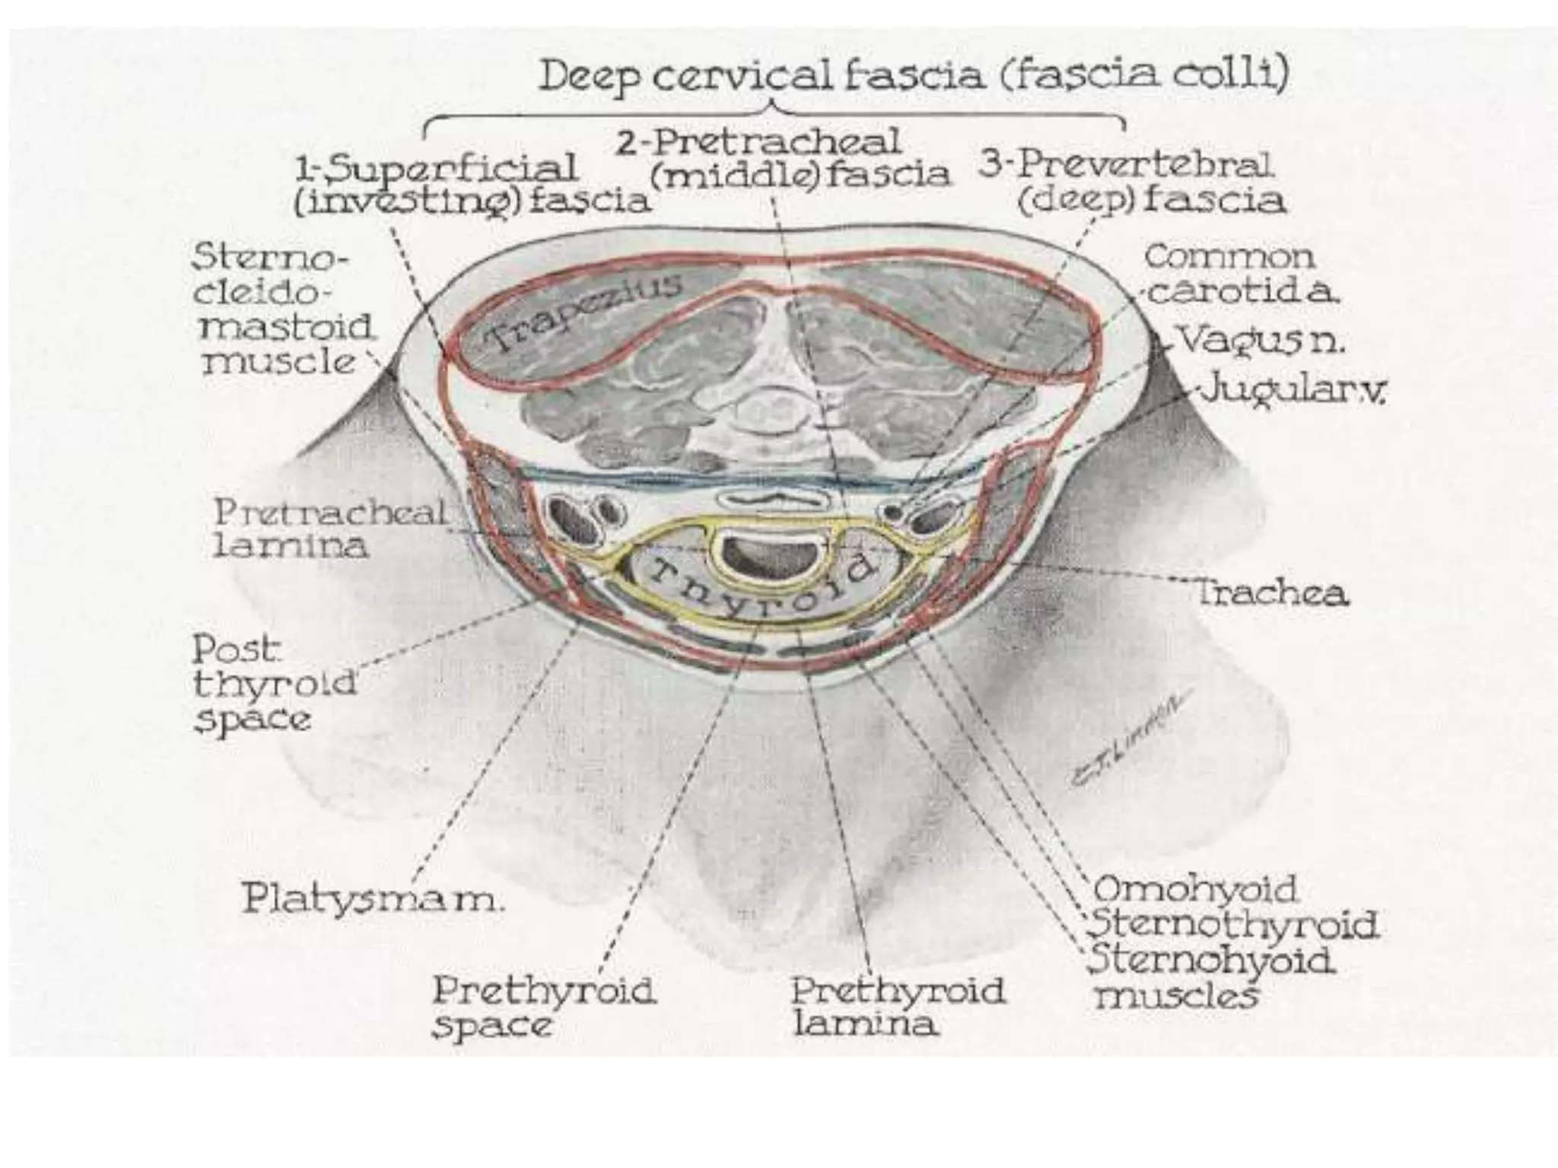

Slide 8
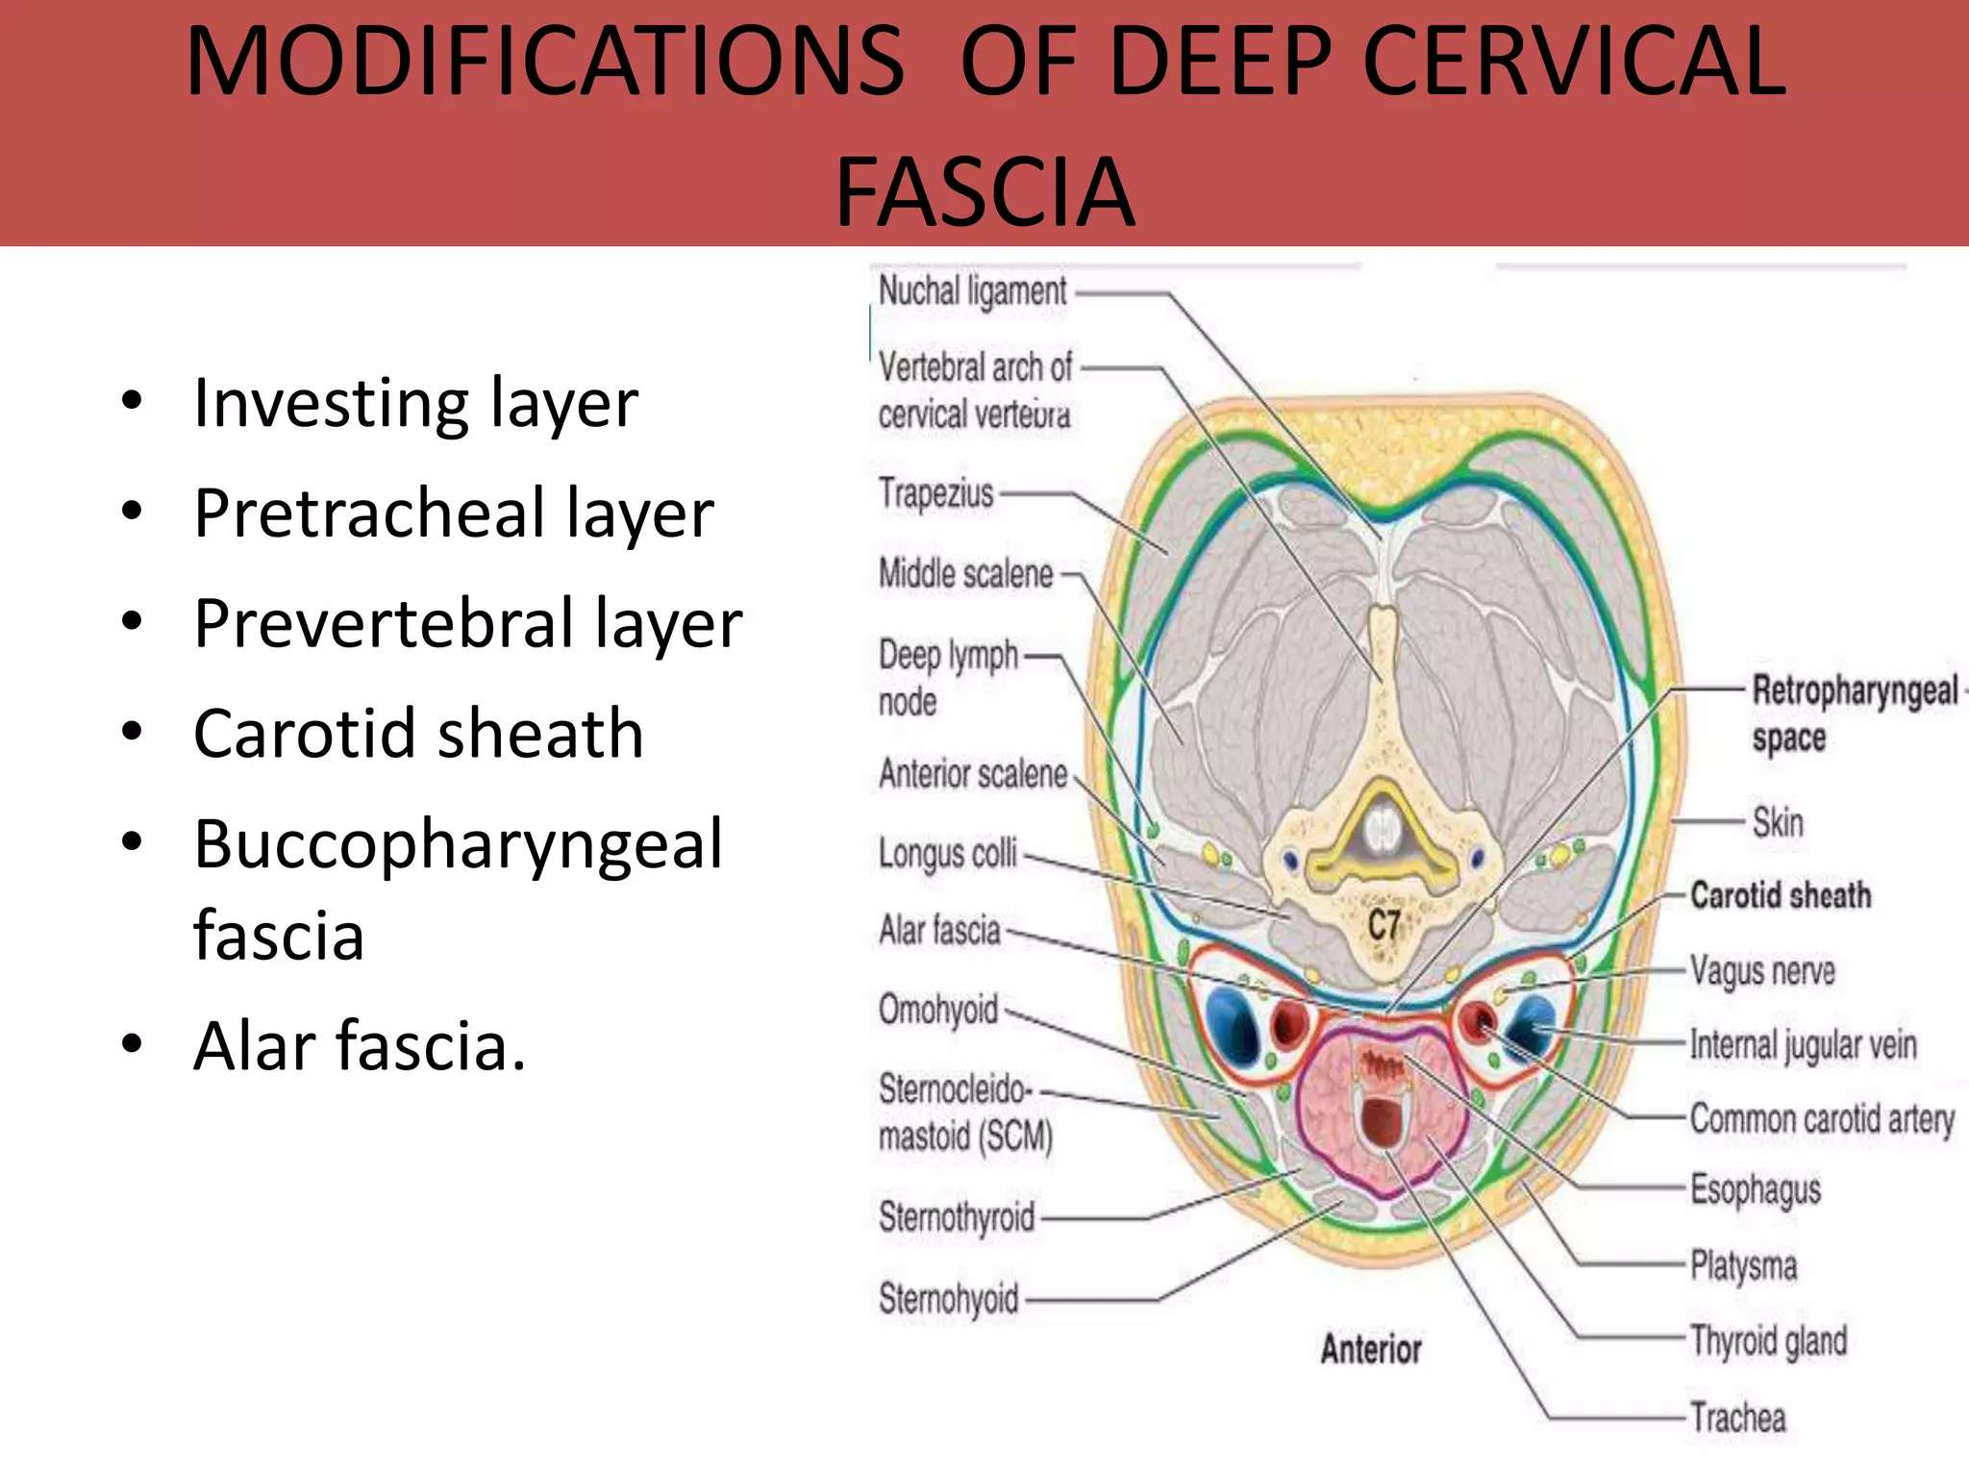

Slide 9
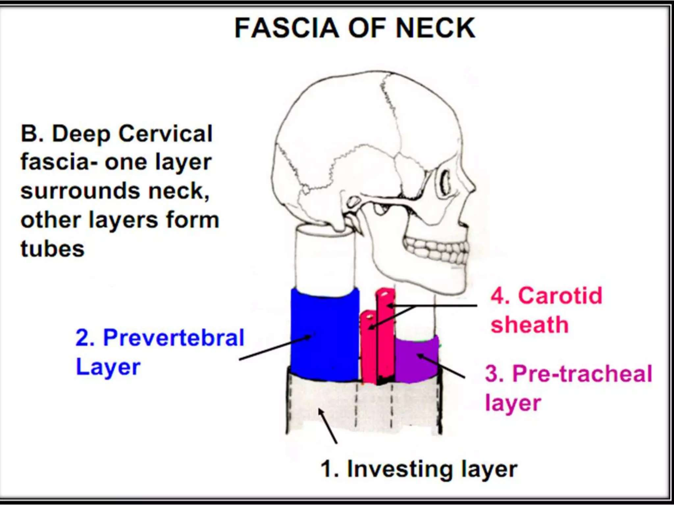

Slide 10
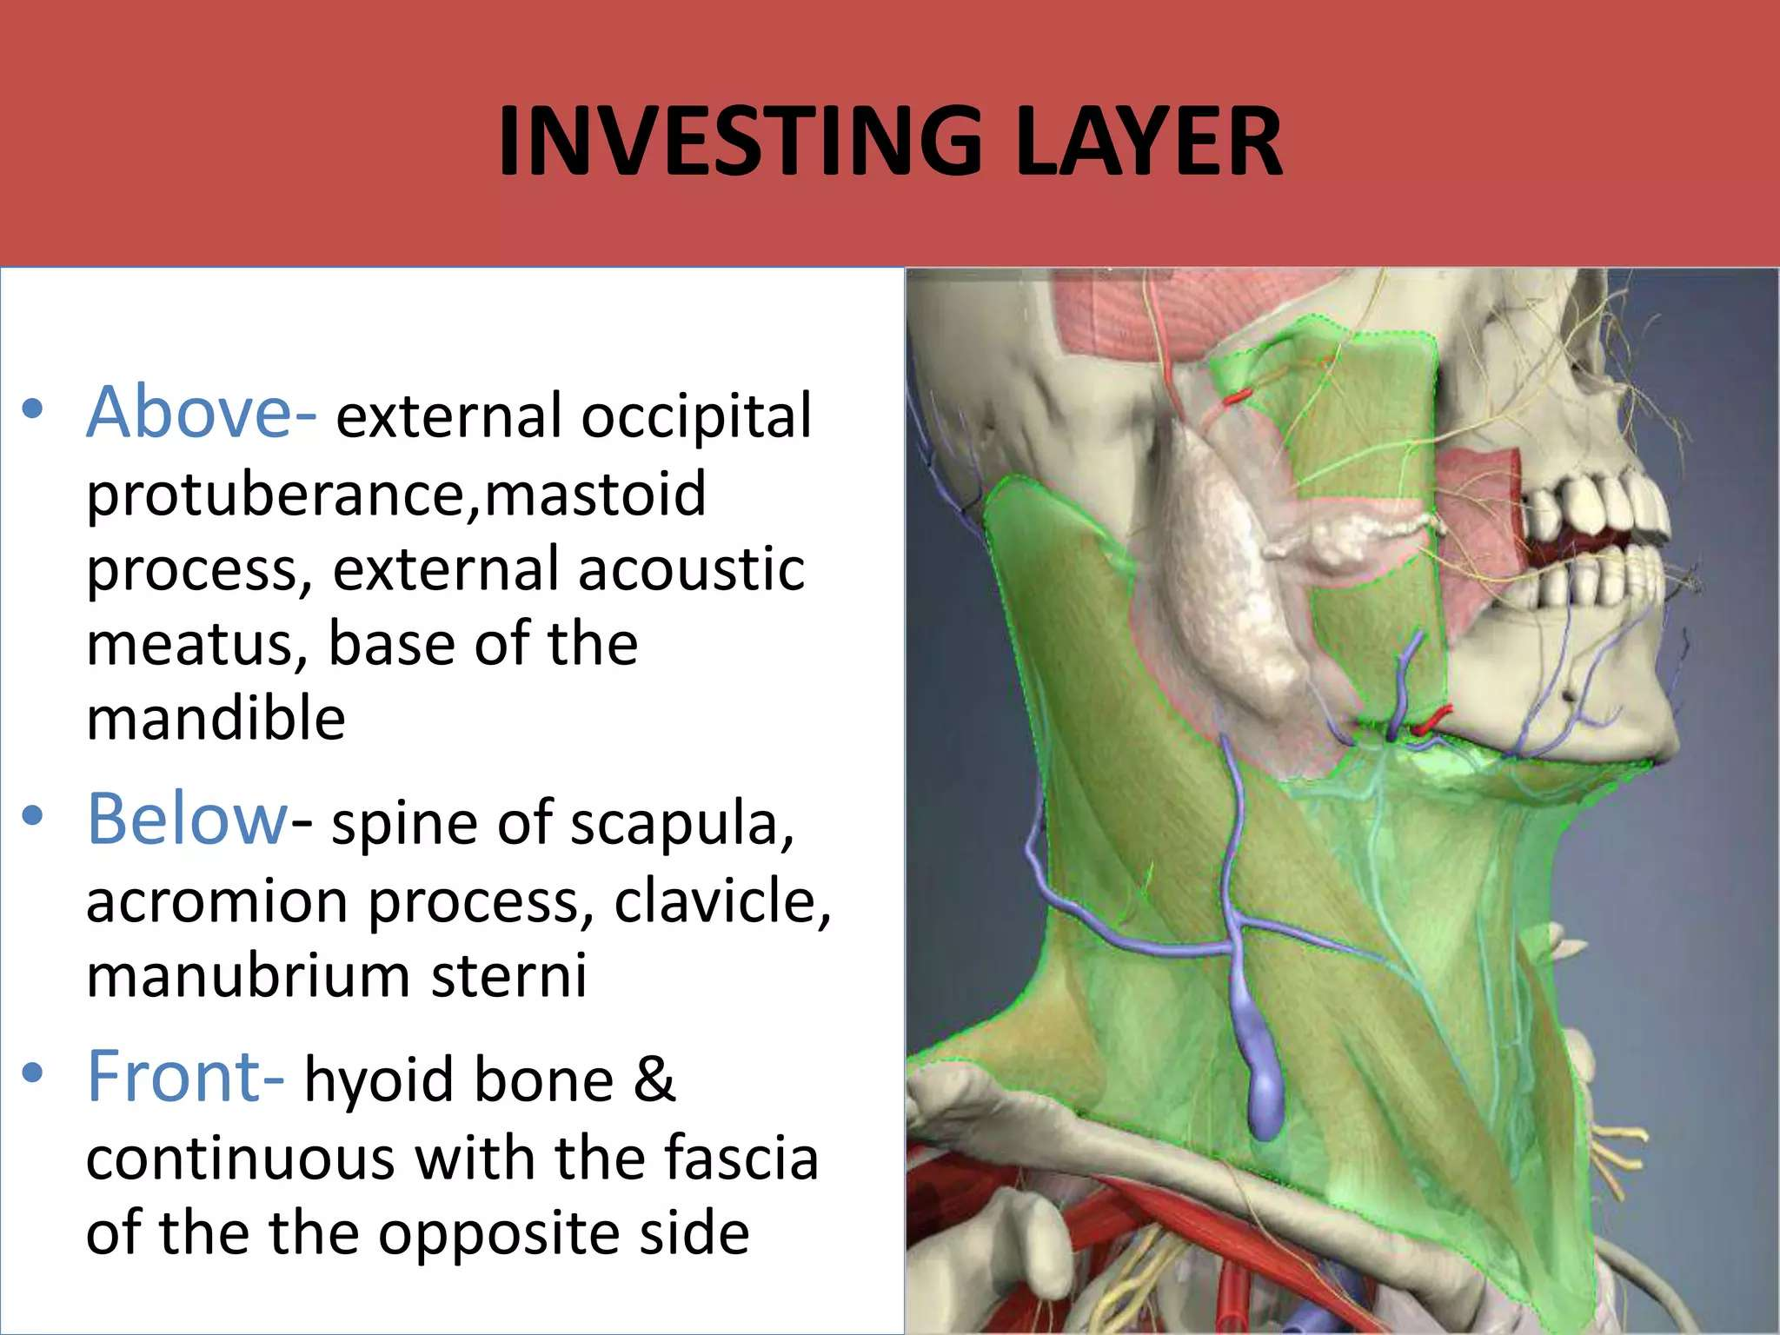

Slide 11
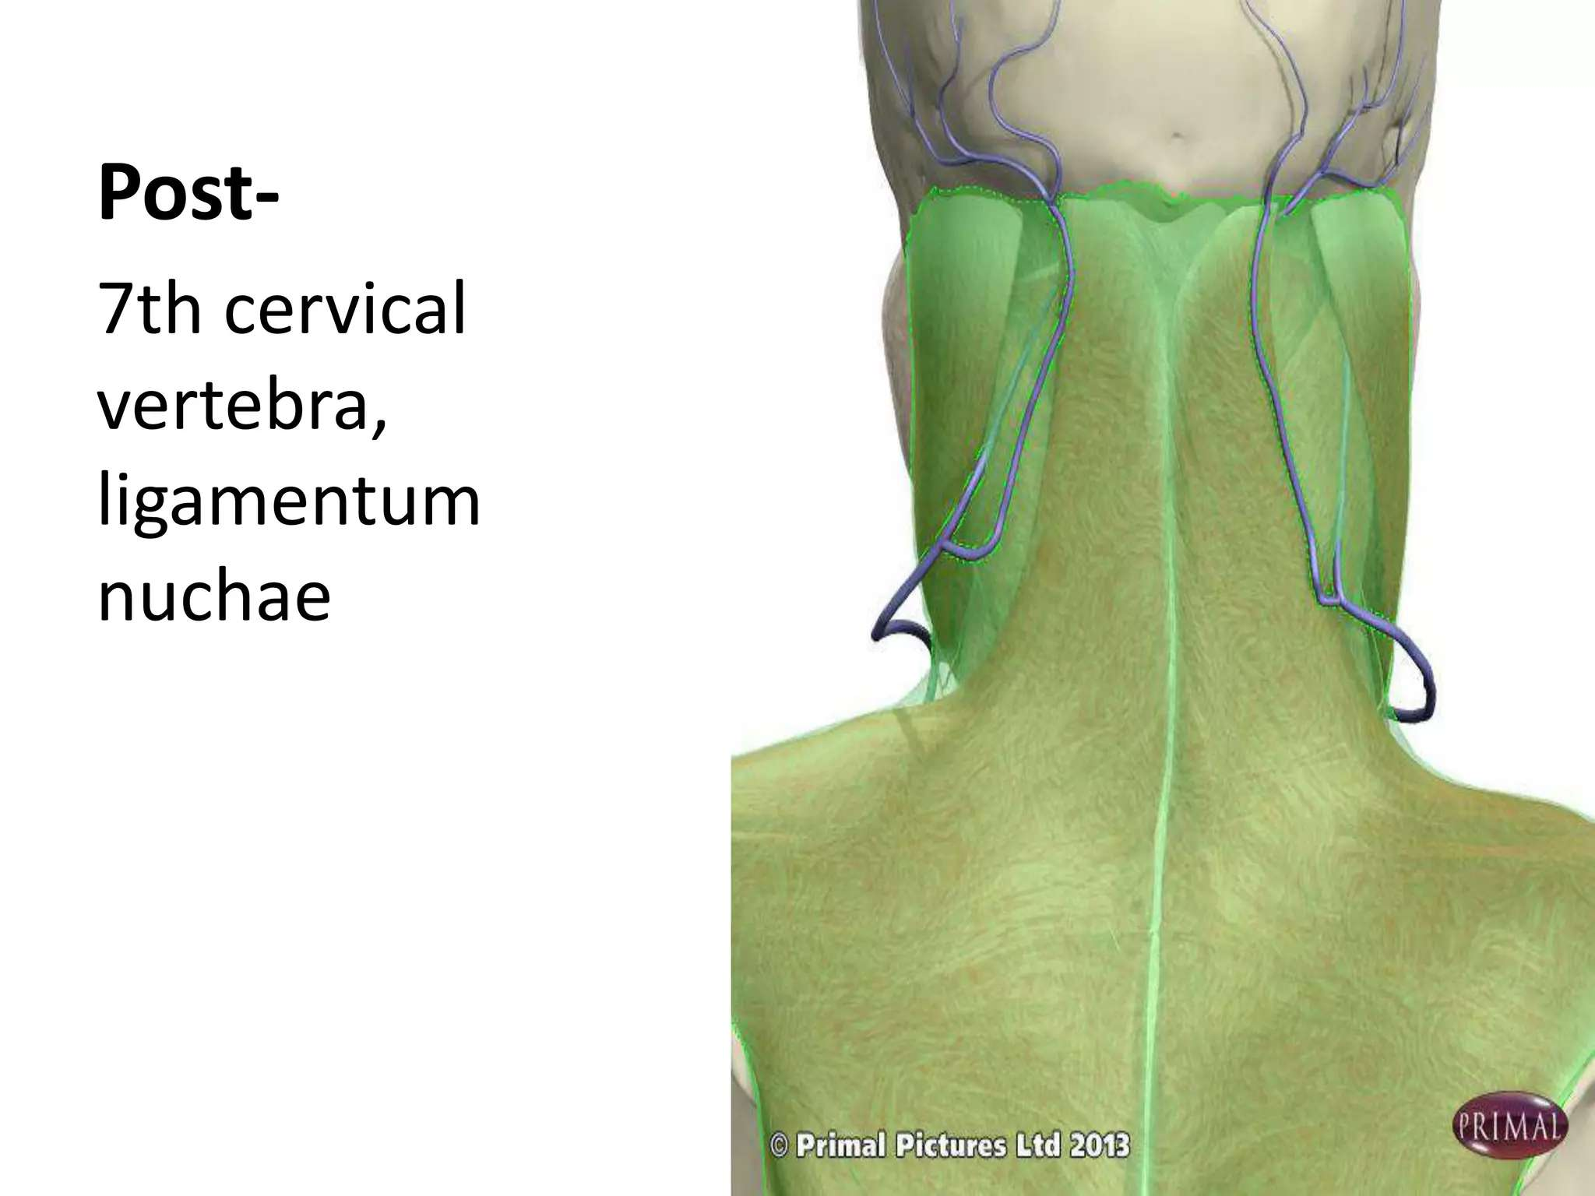

Slide 12
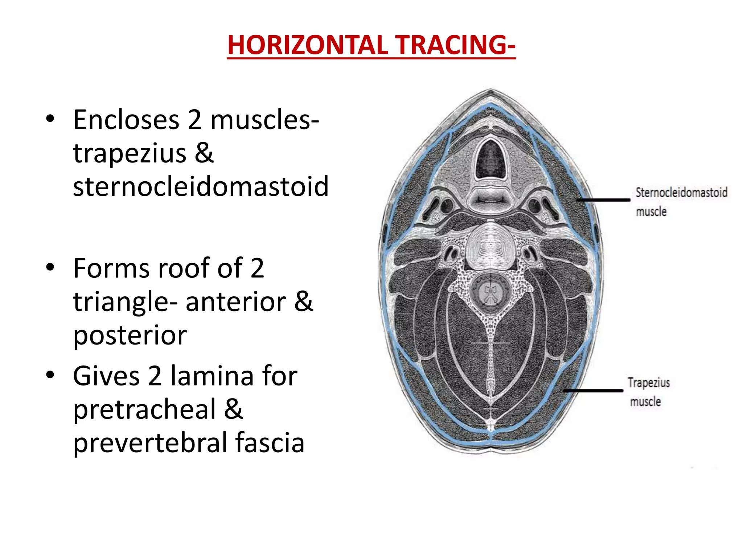

Slide 13
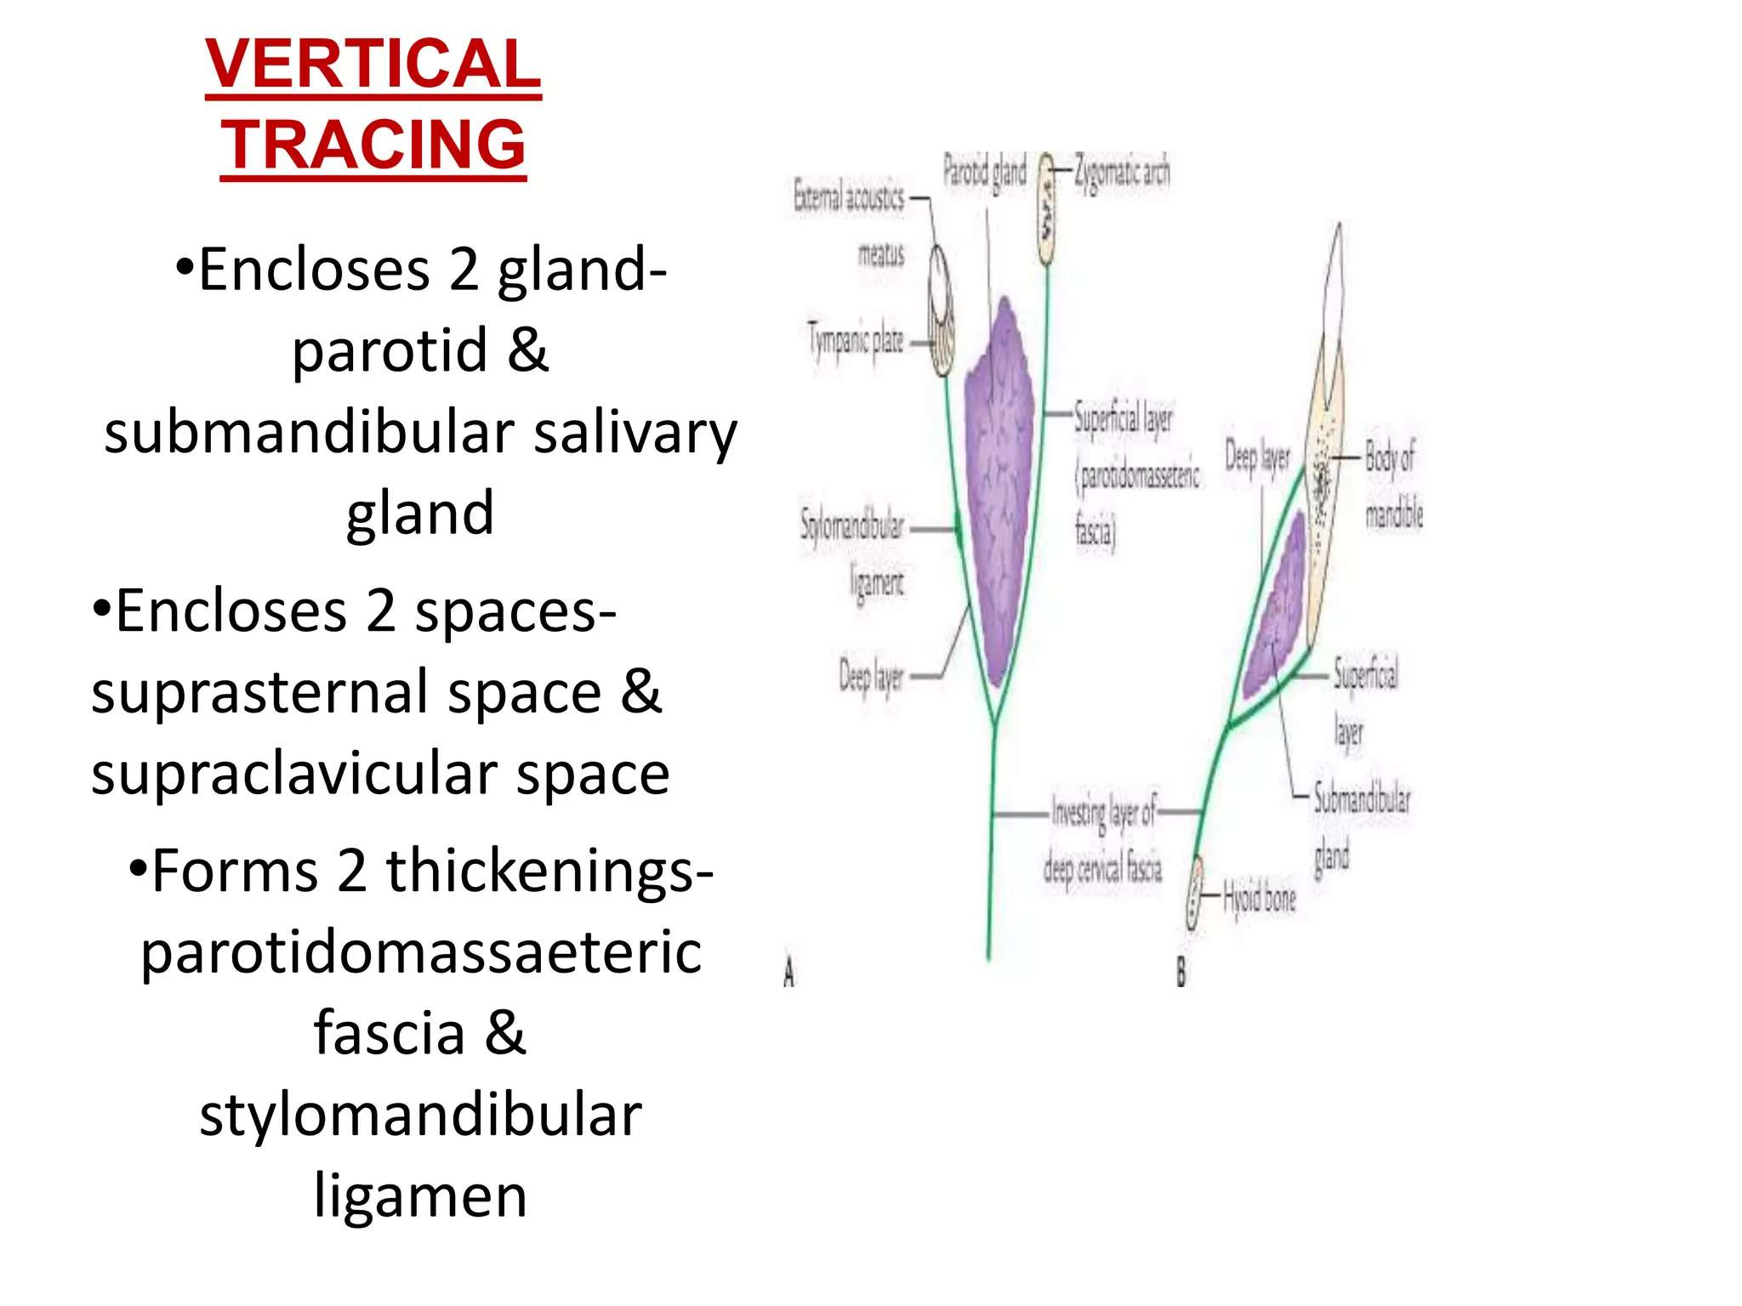

Slide 14
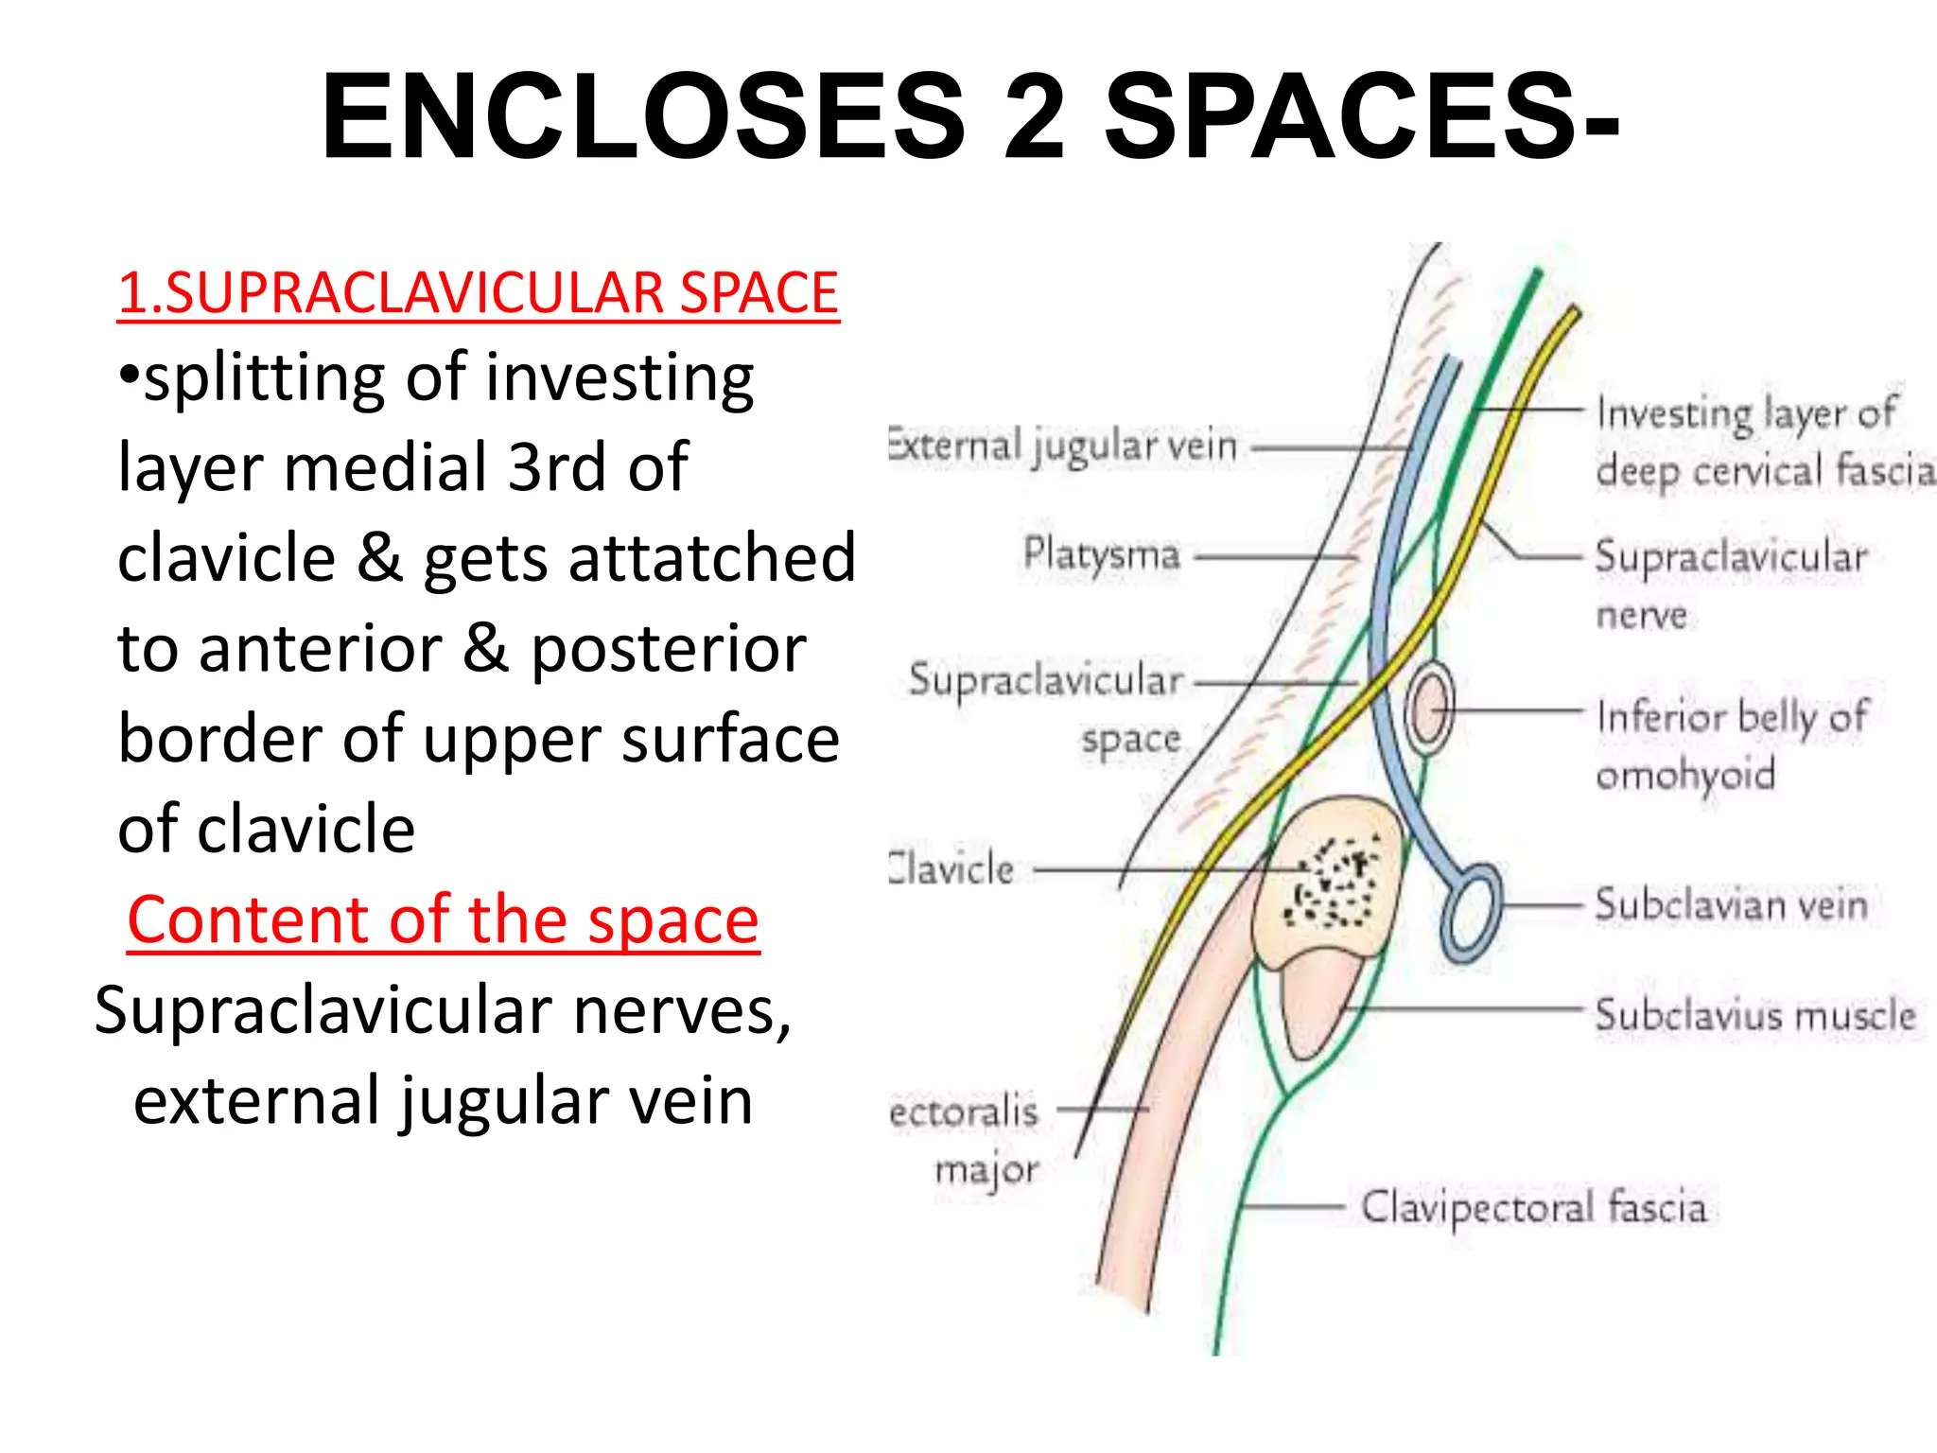

Slide 15
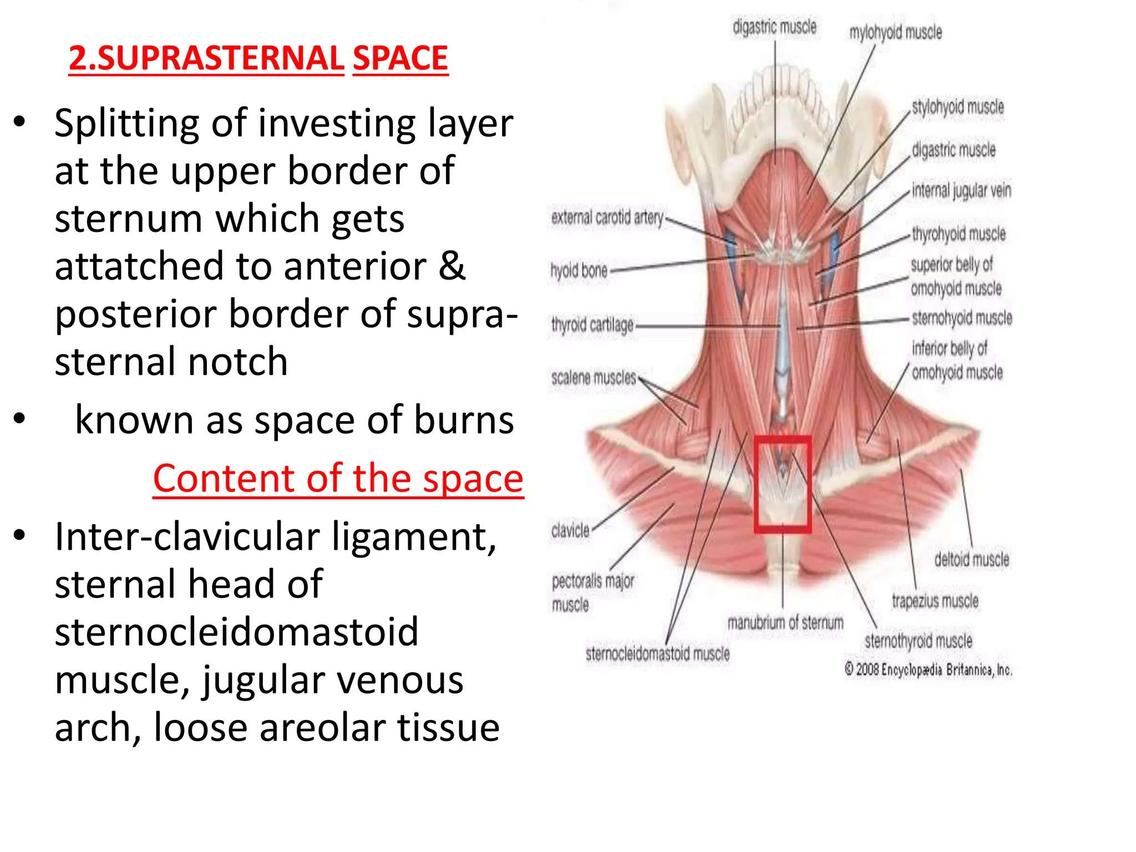

Slide 16
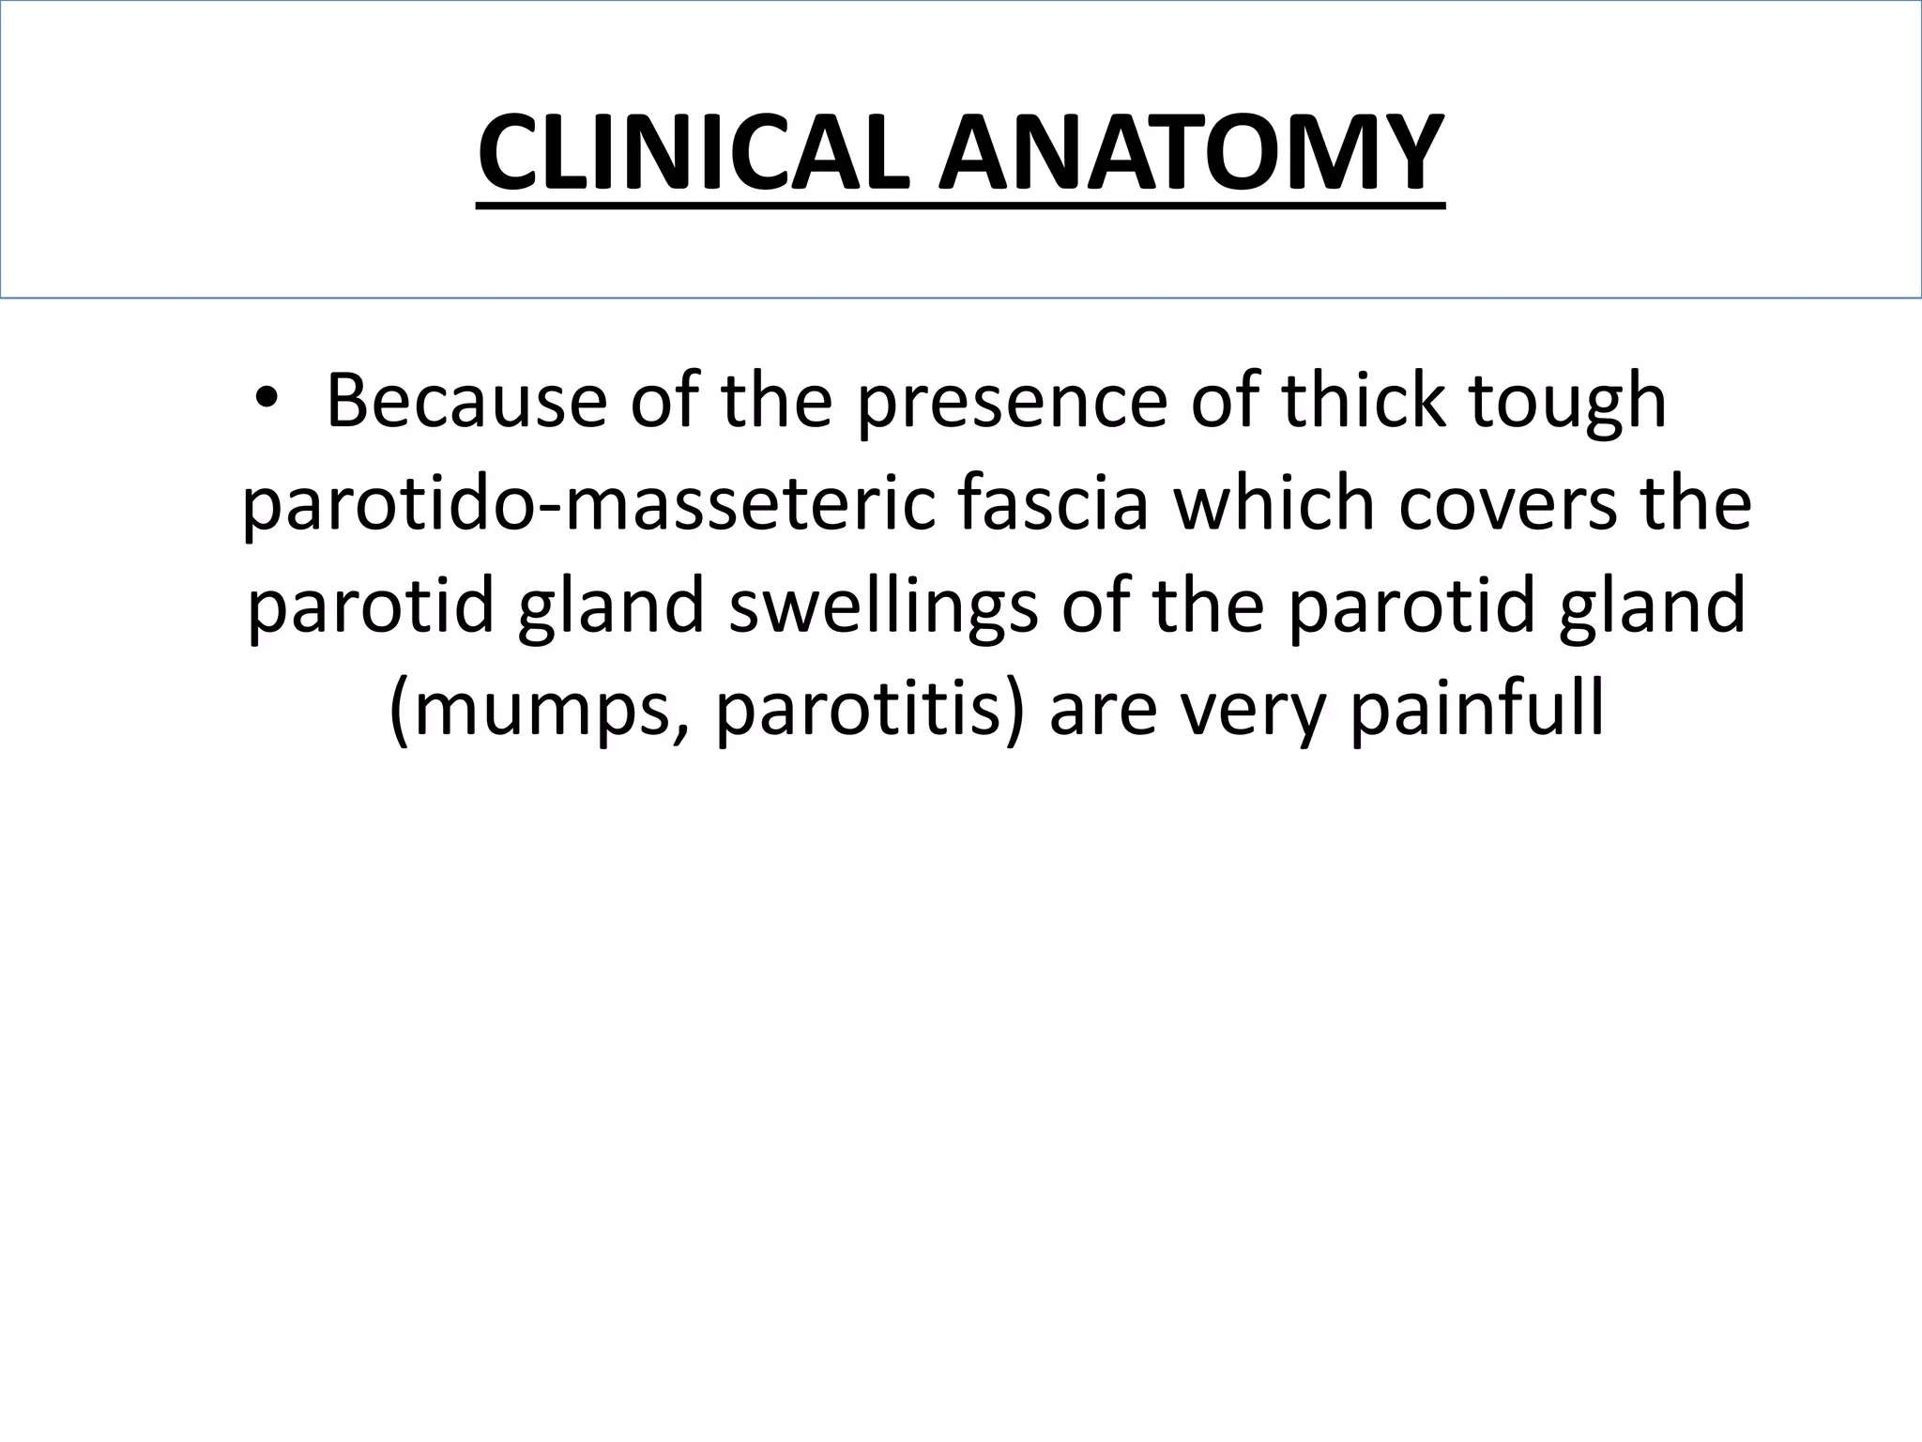

Slide 17
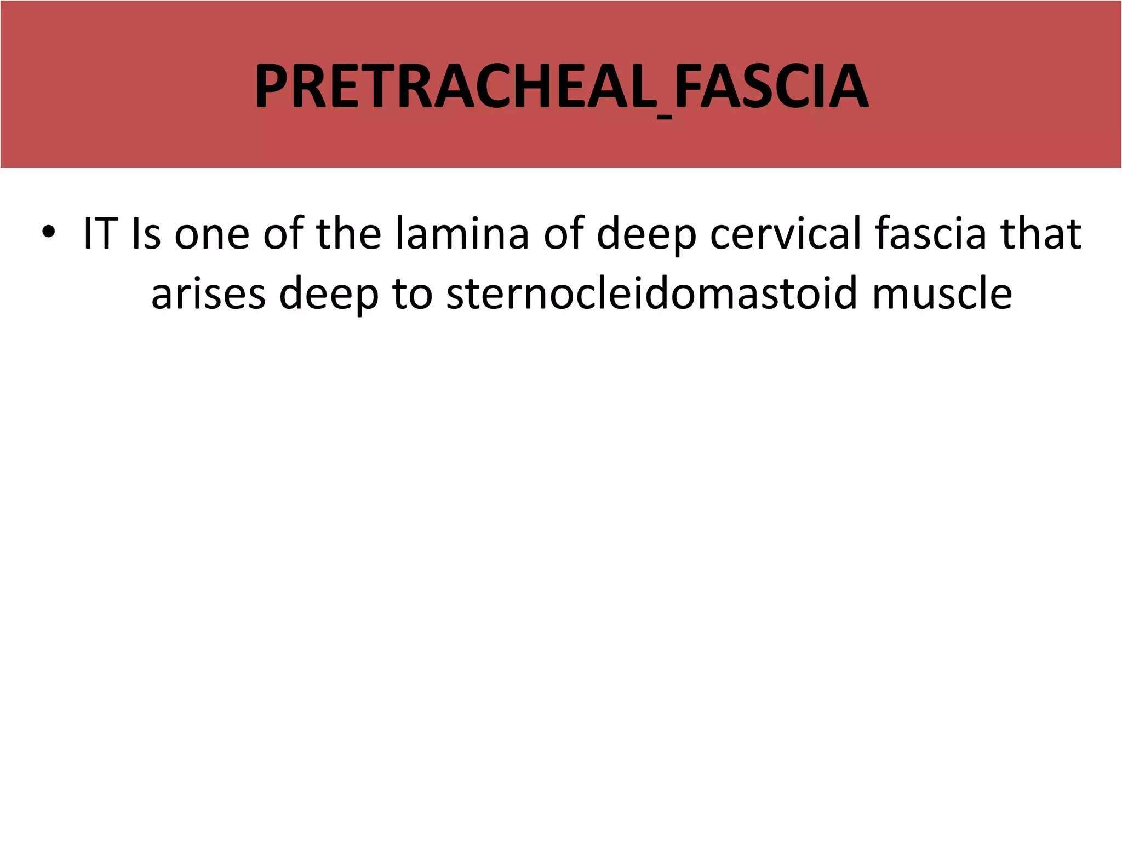

Slide 18
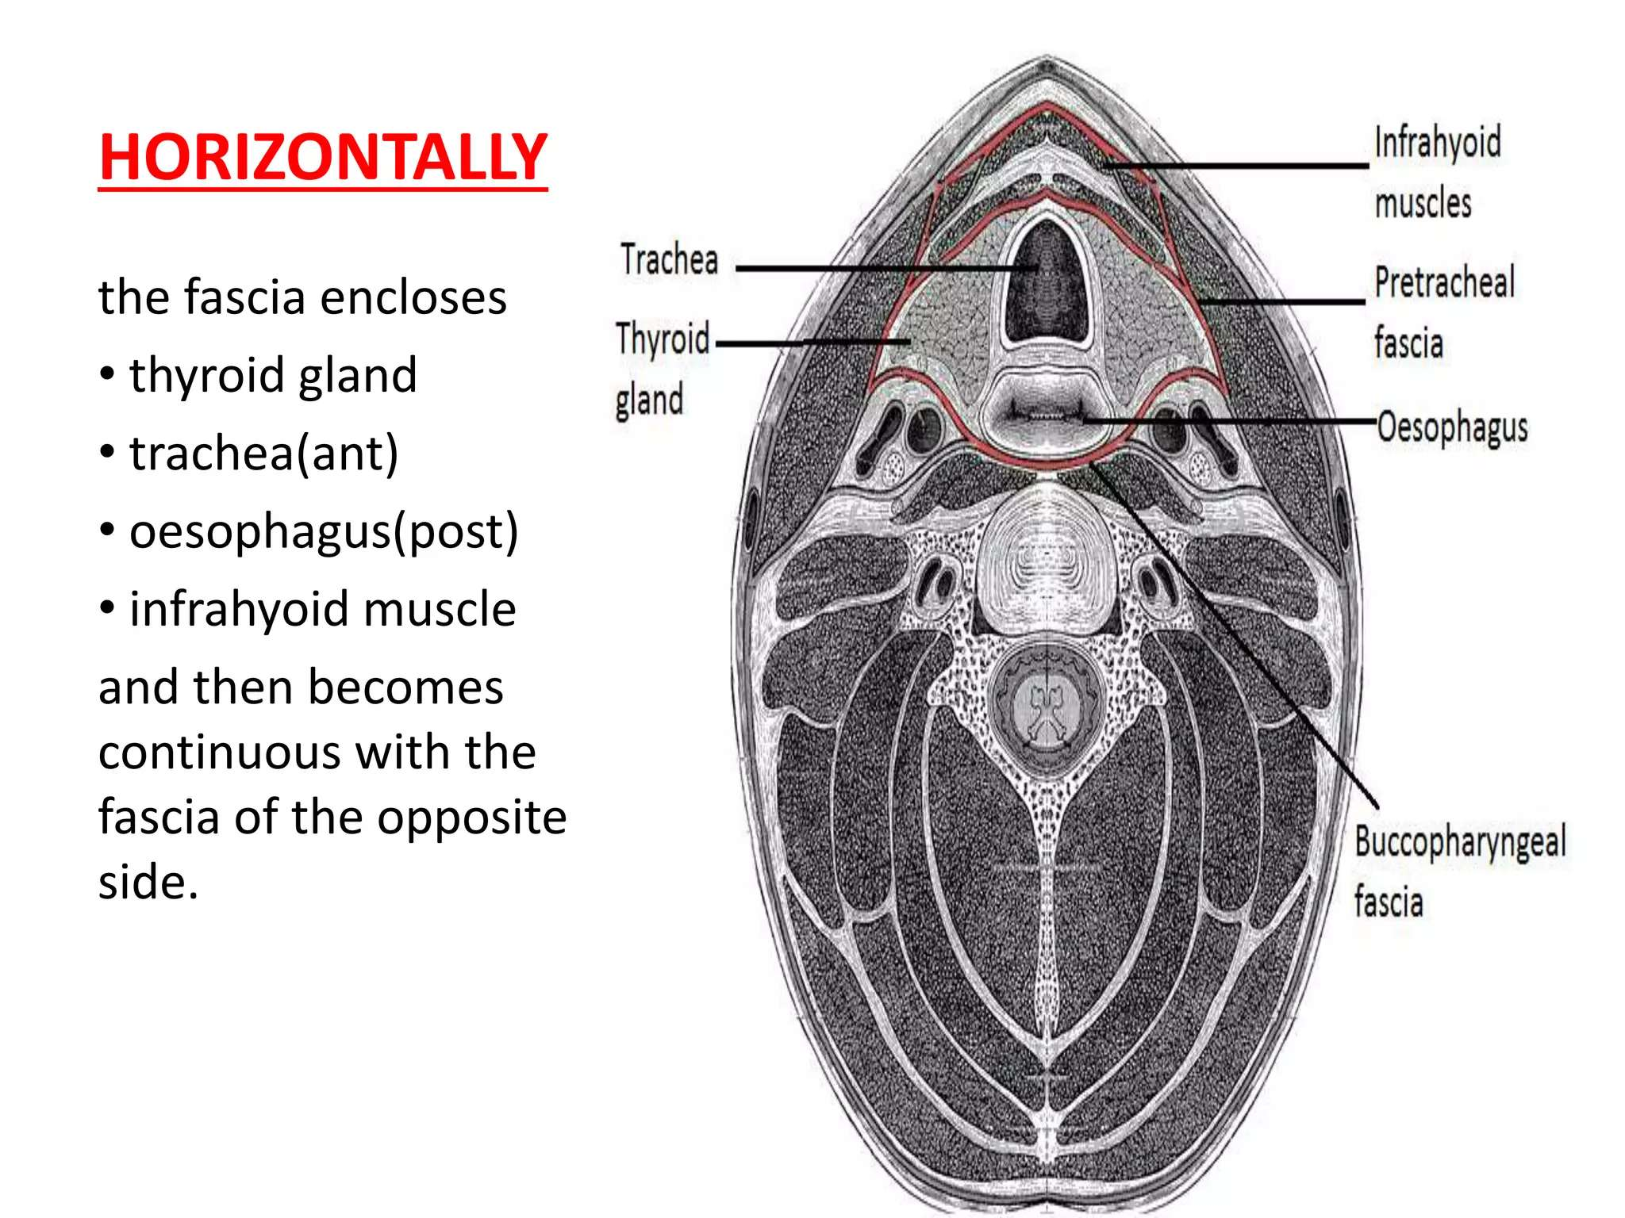

Slide 19
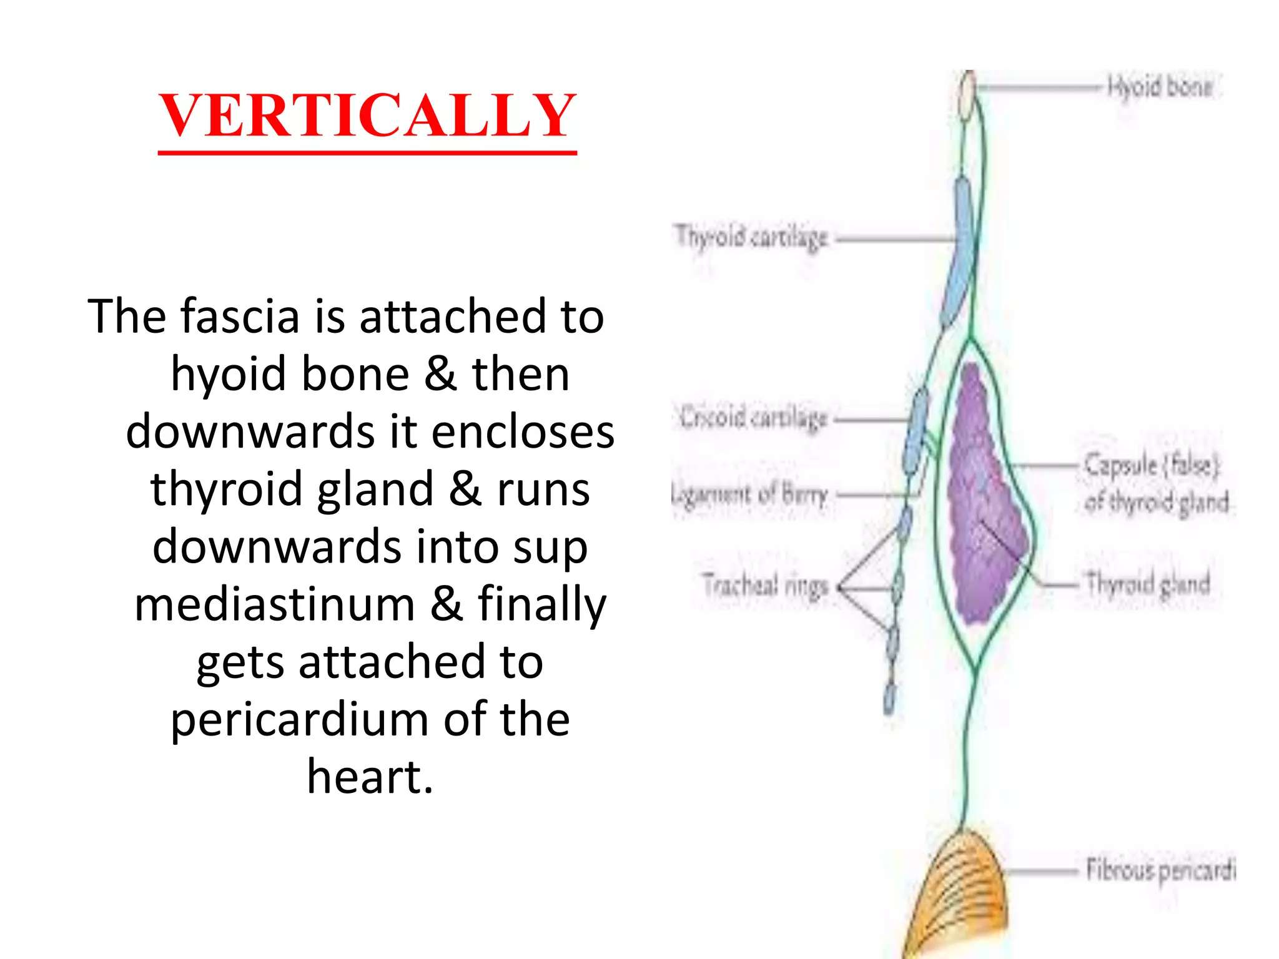

Slide 20
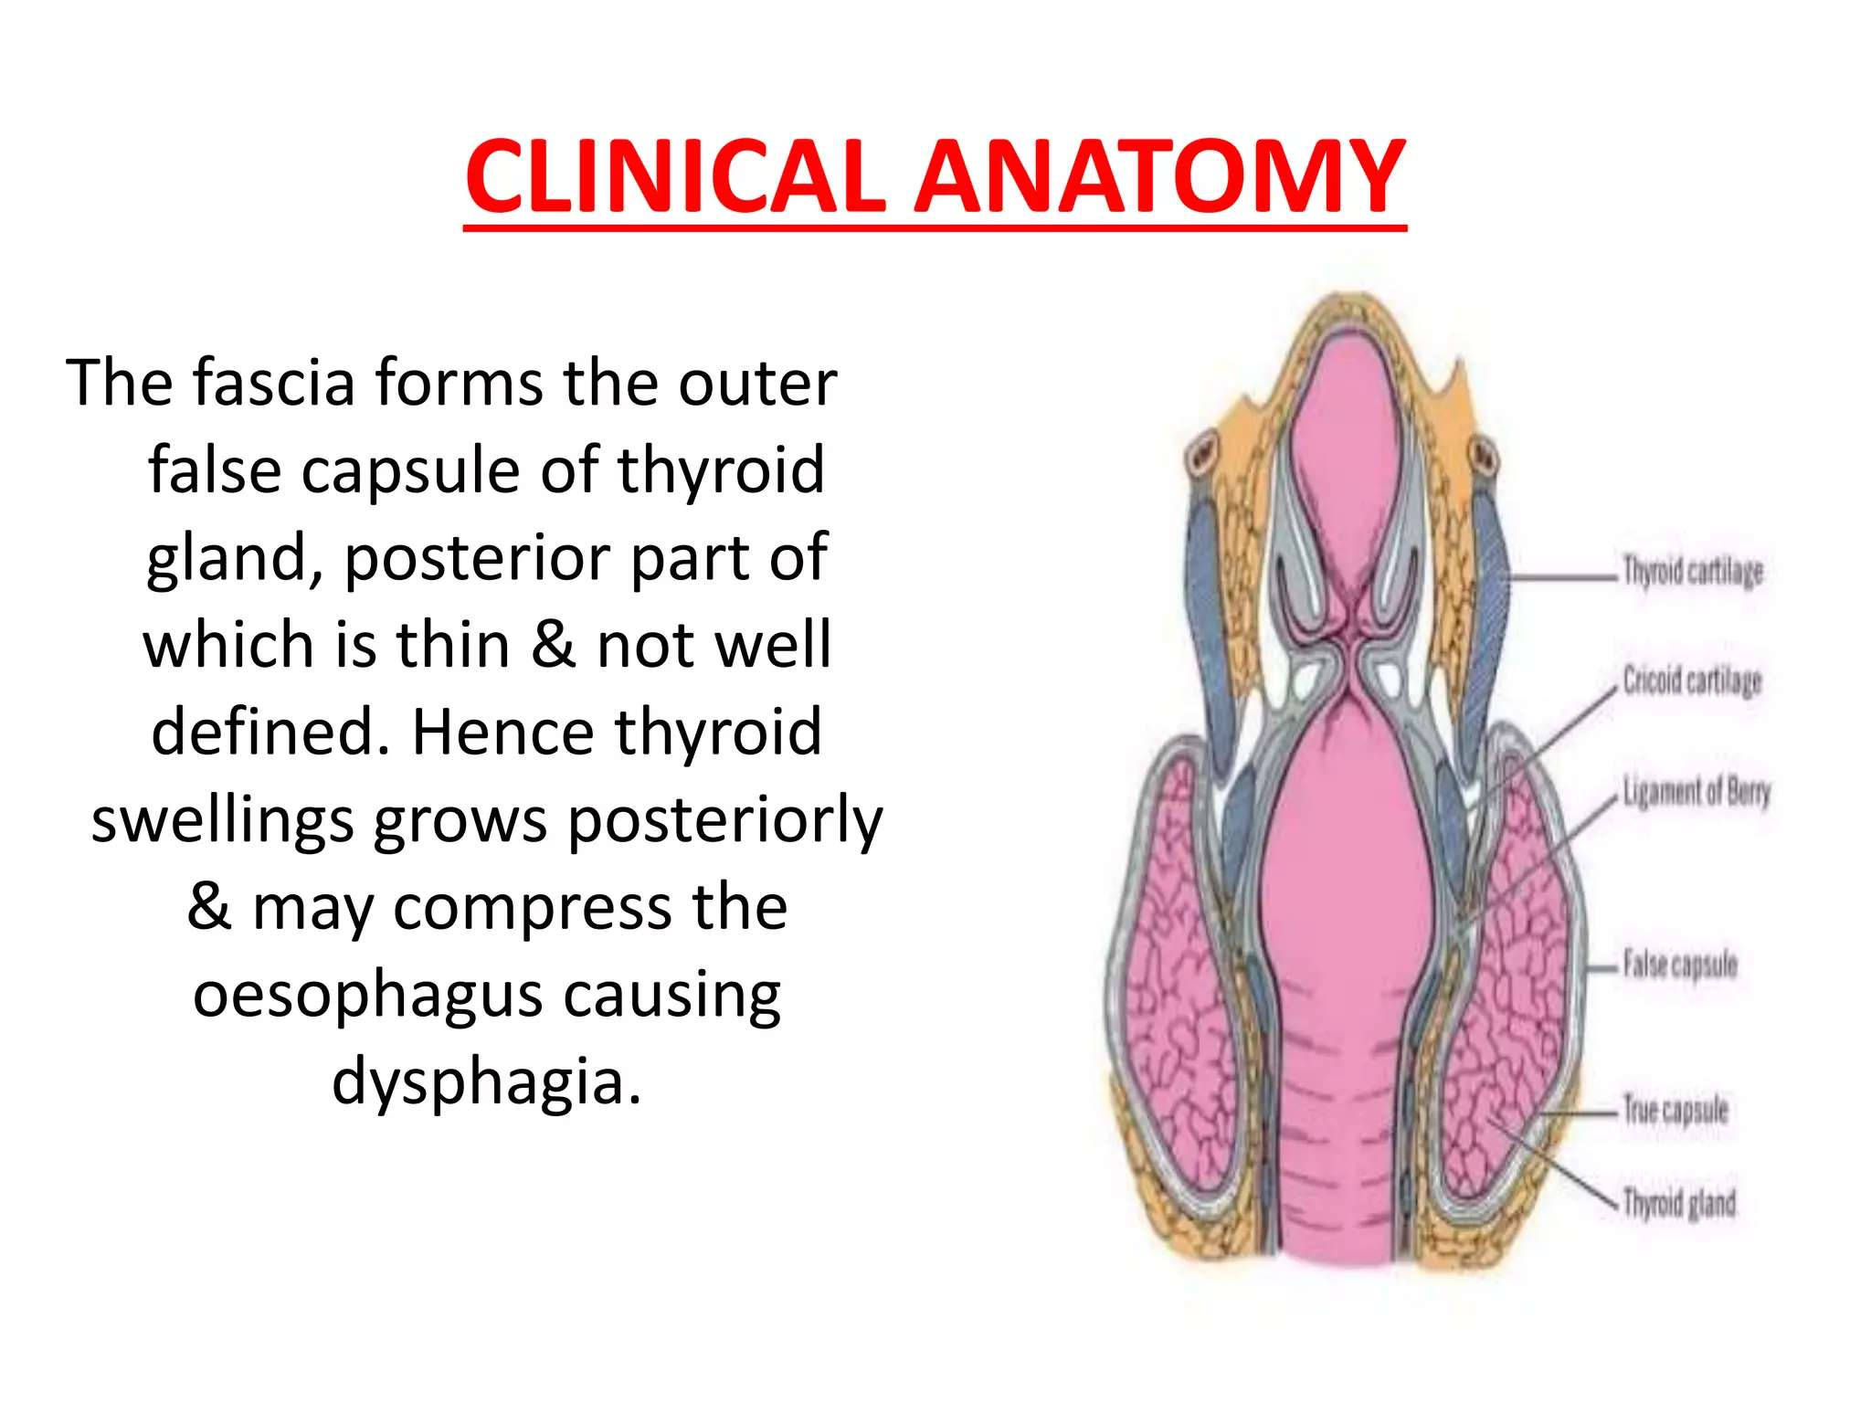

Slide 21
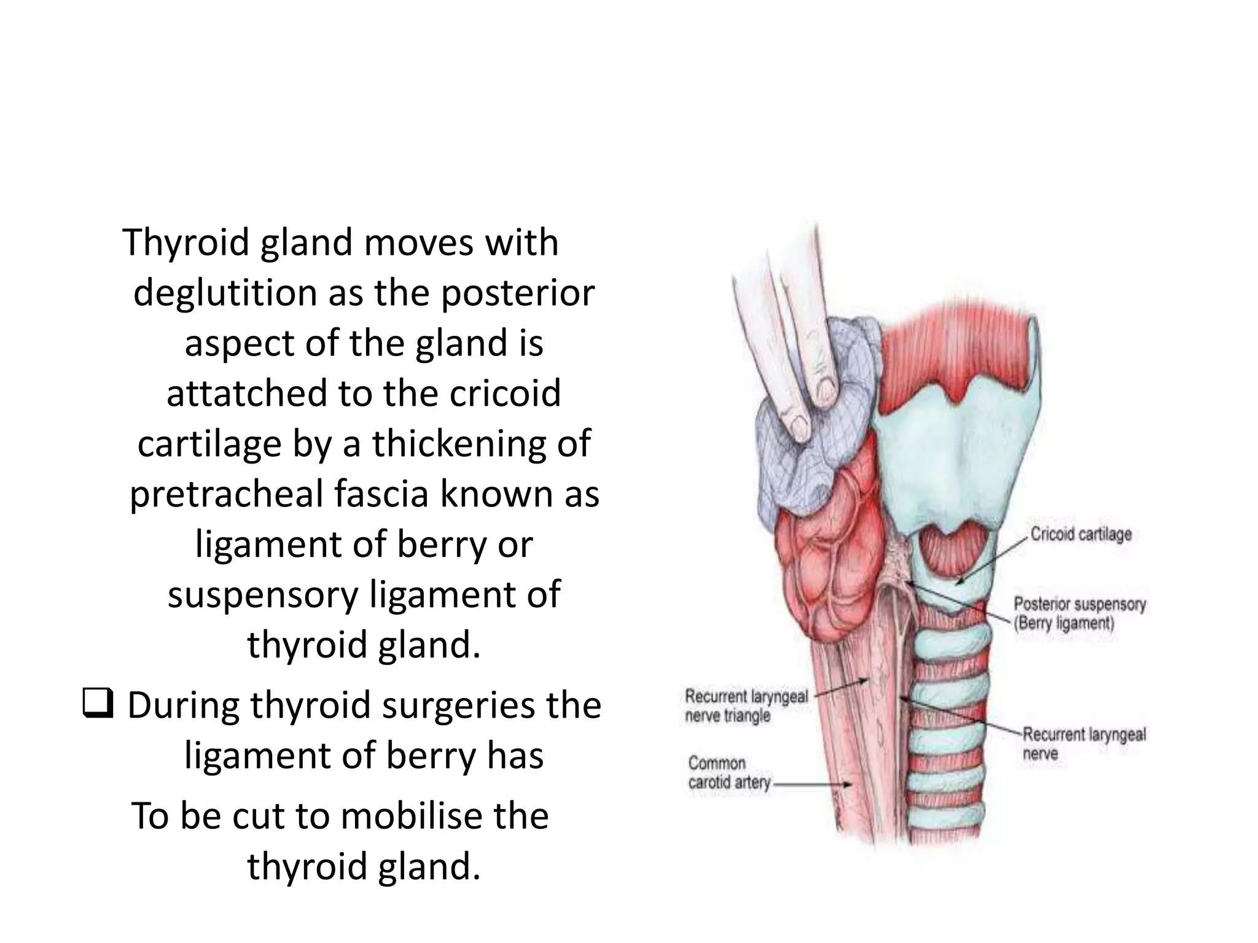

Slide 22
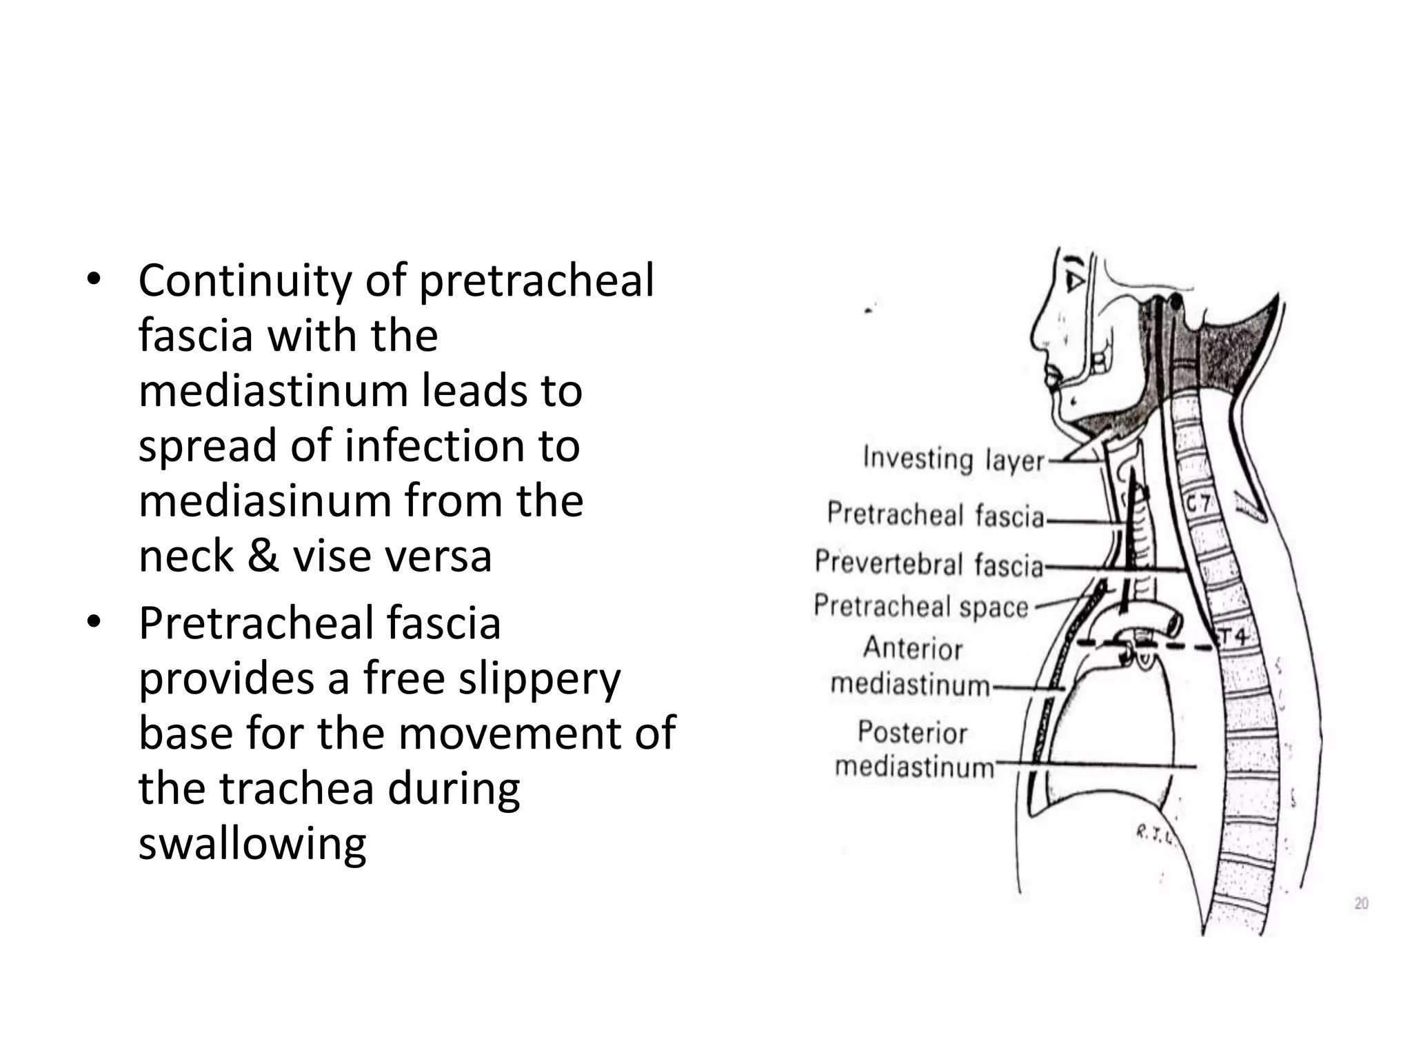

Slide 23
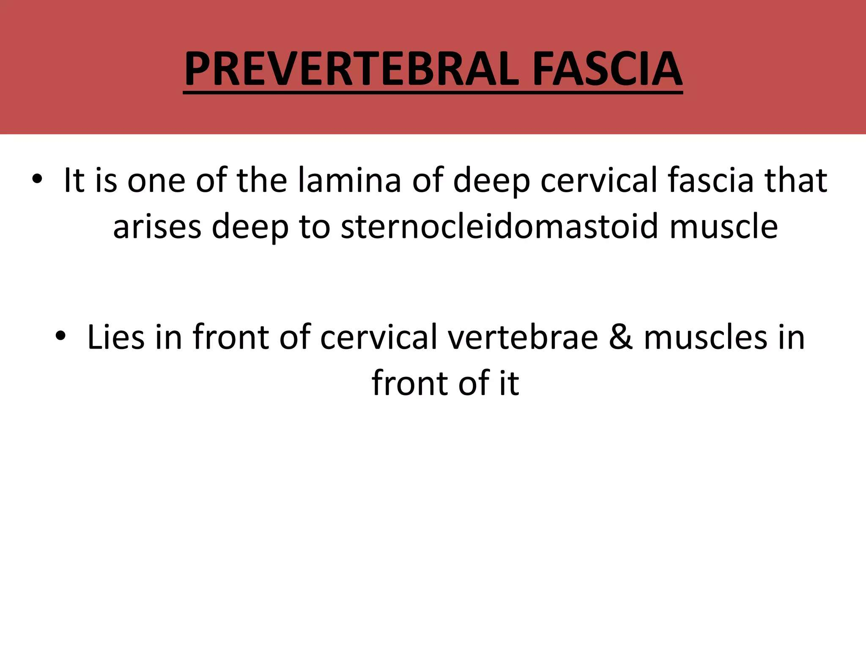

Slide 24
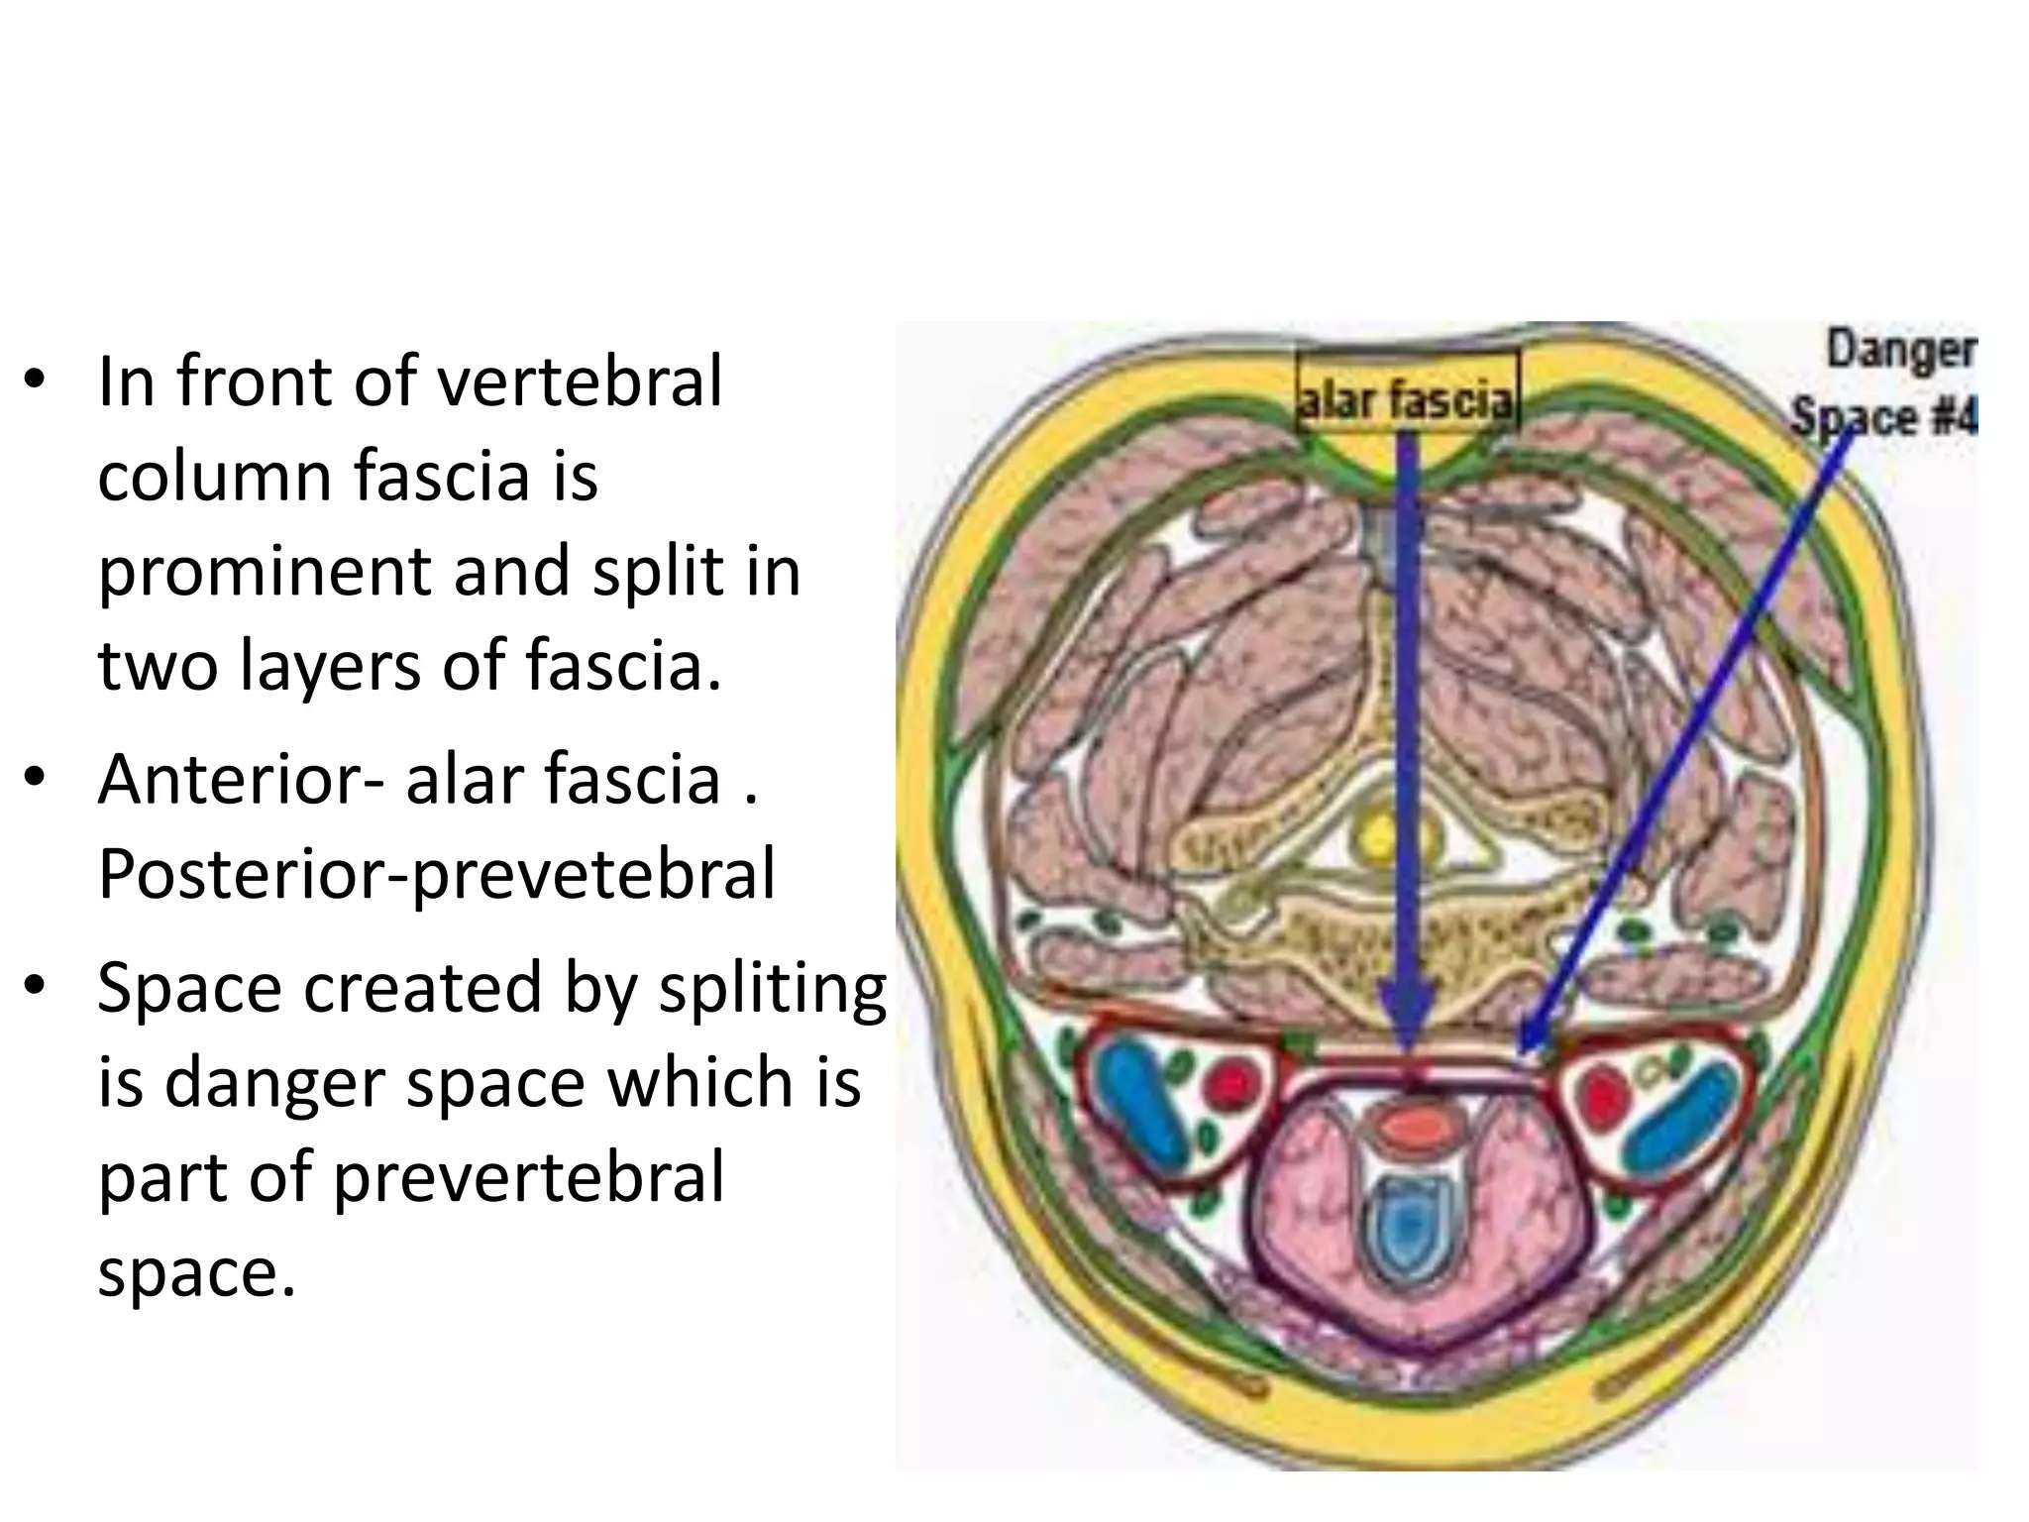

Slide 25
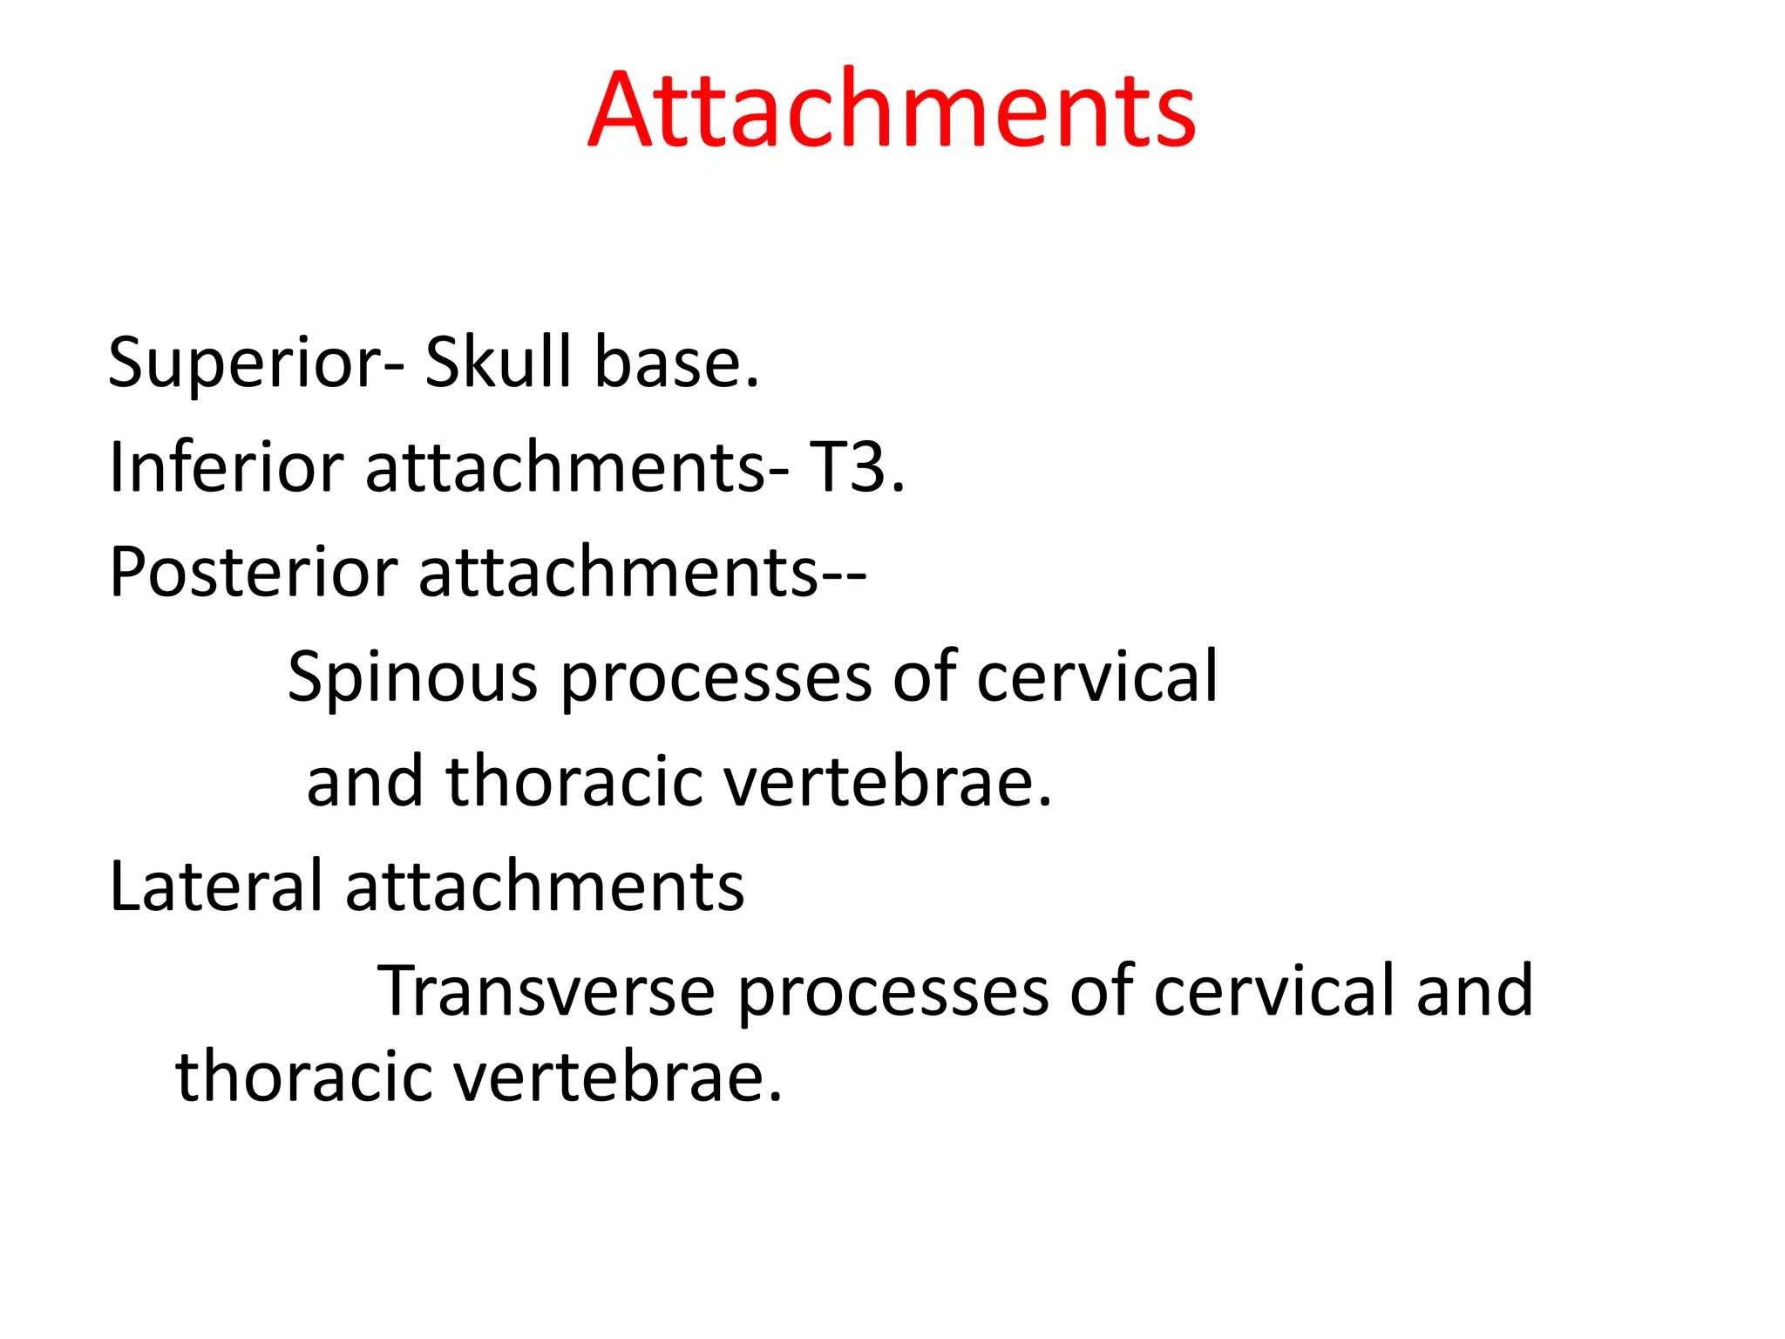

Slide 26
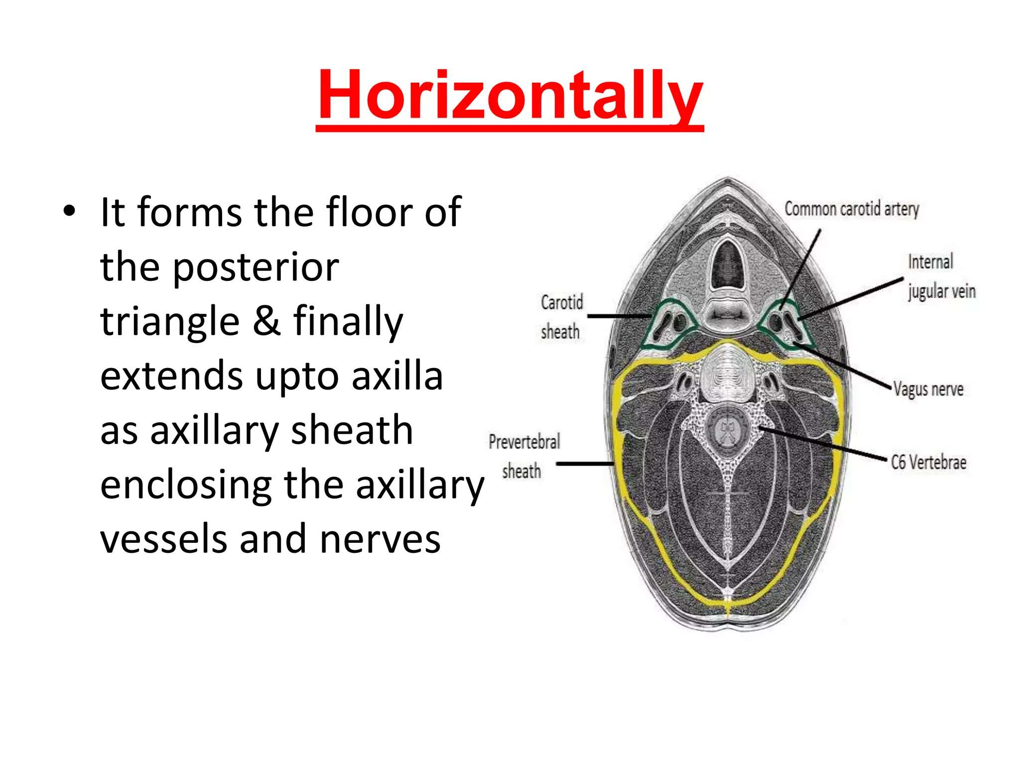

Slide 27
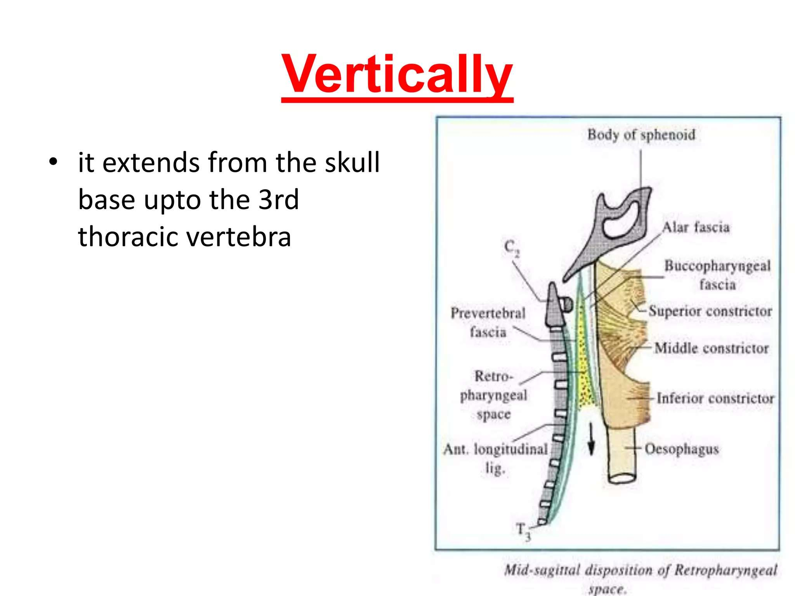

Slide 28
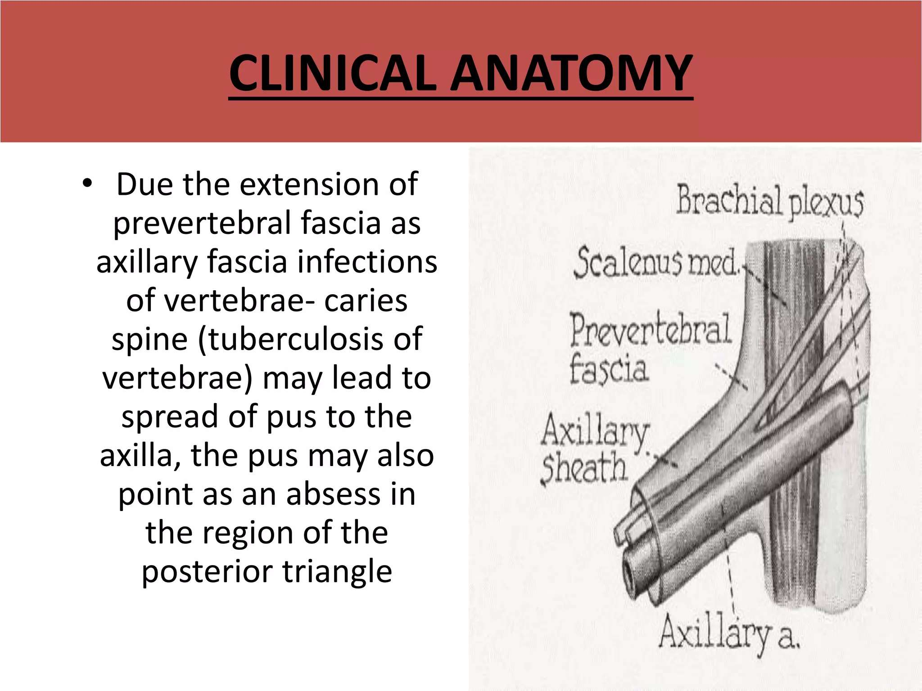

Slide 29
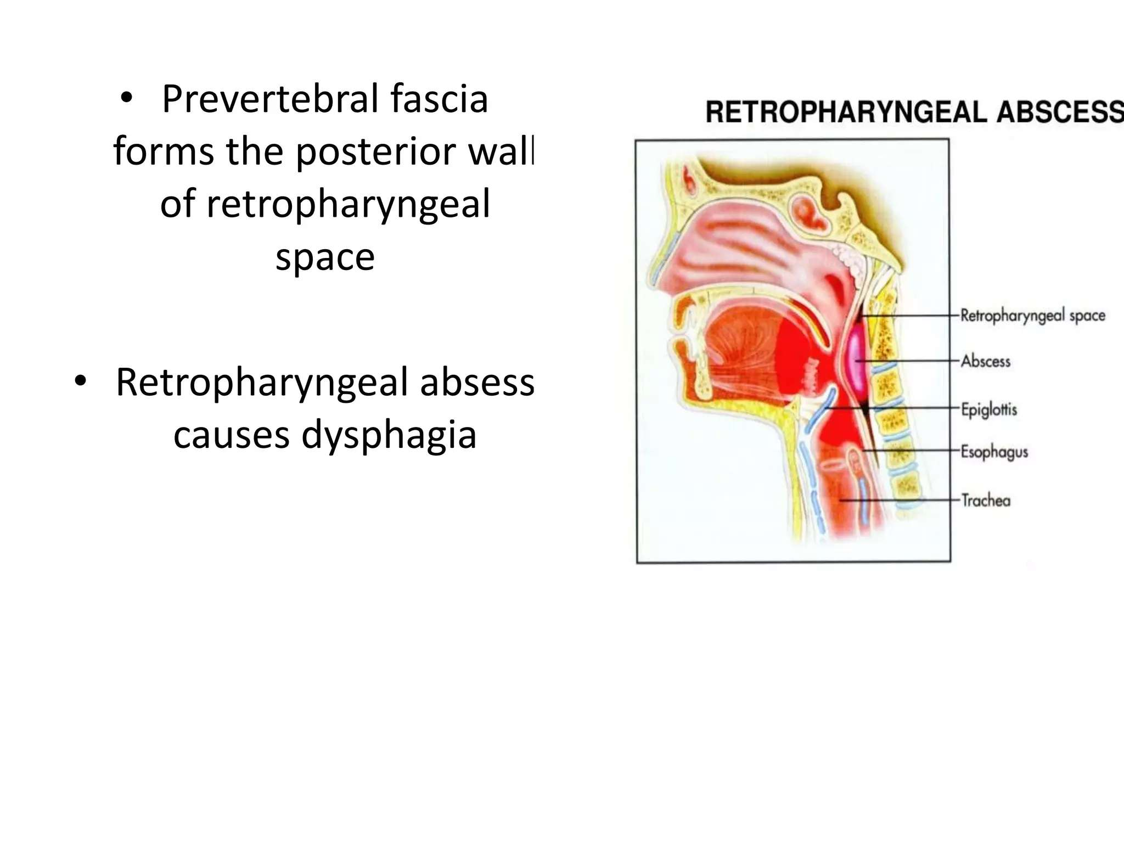

Slide 30
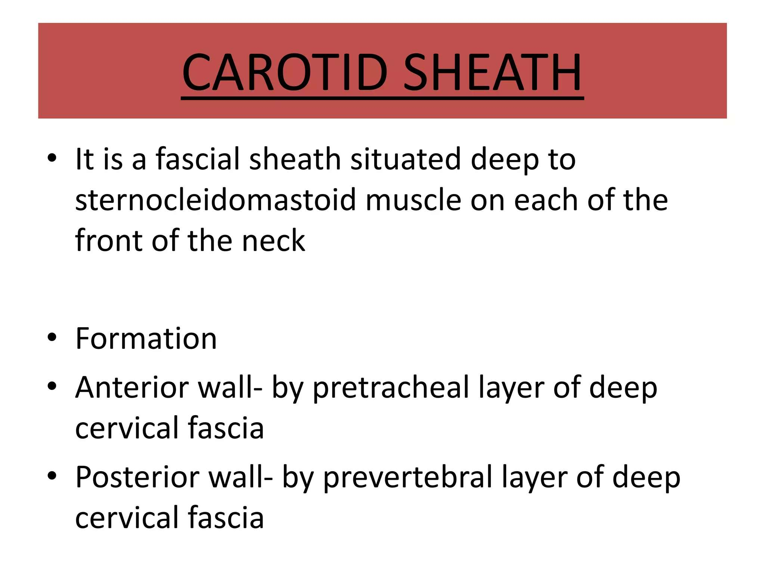

Slide 31
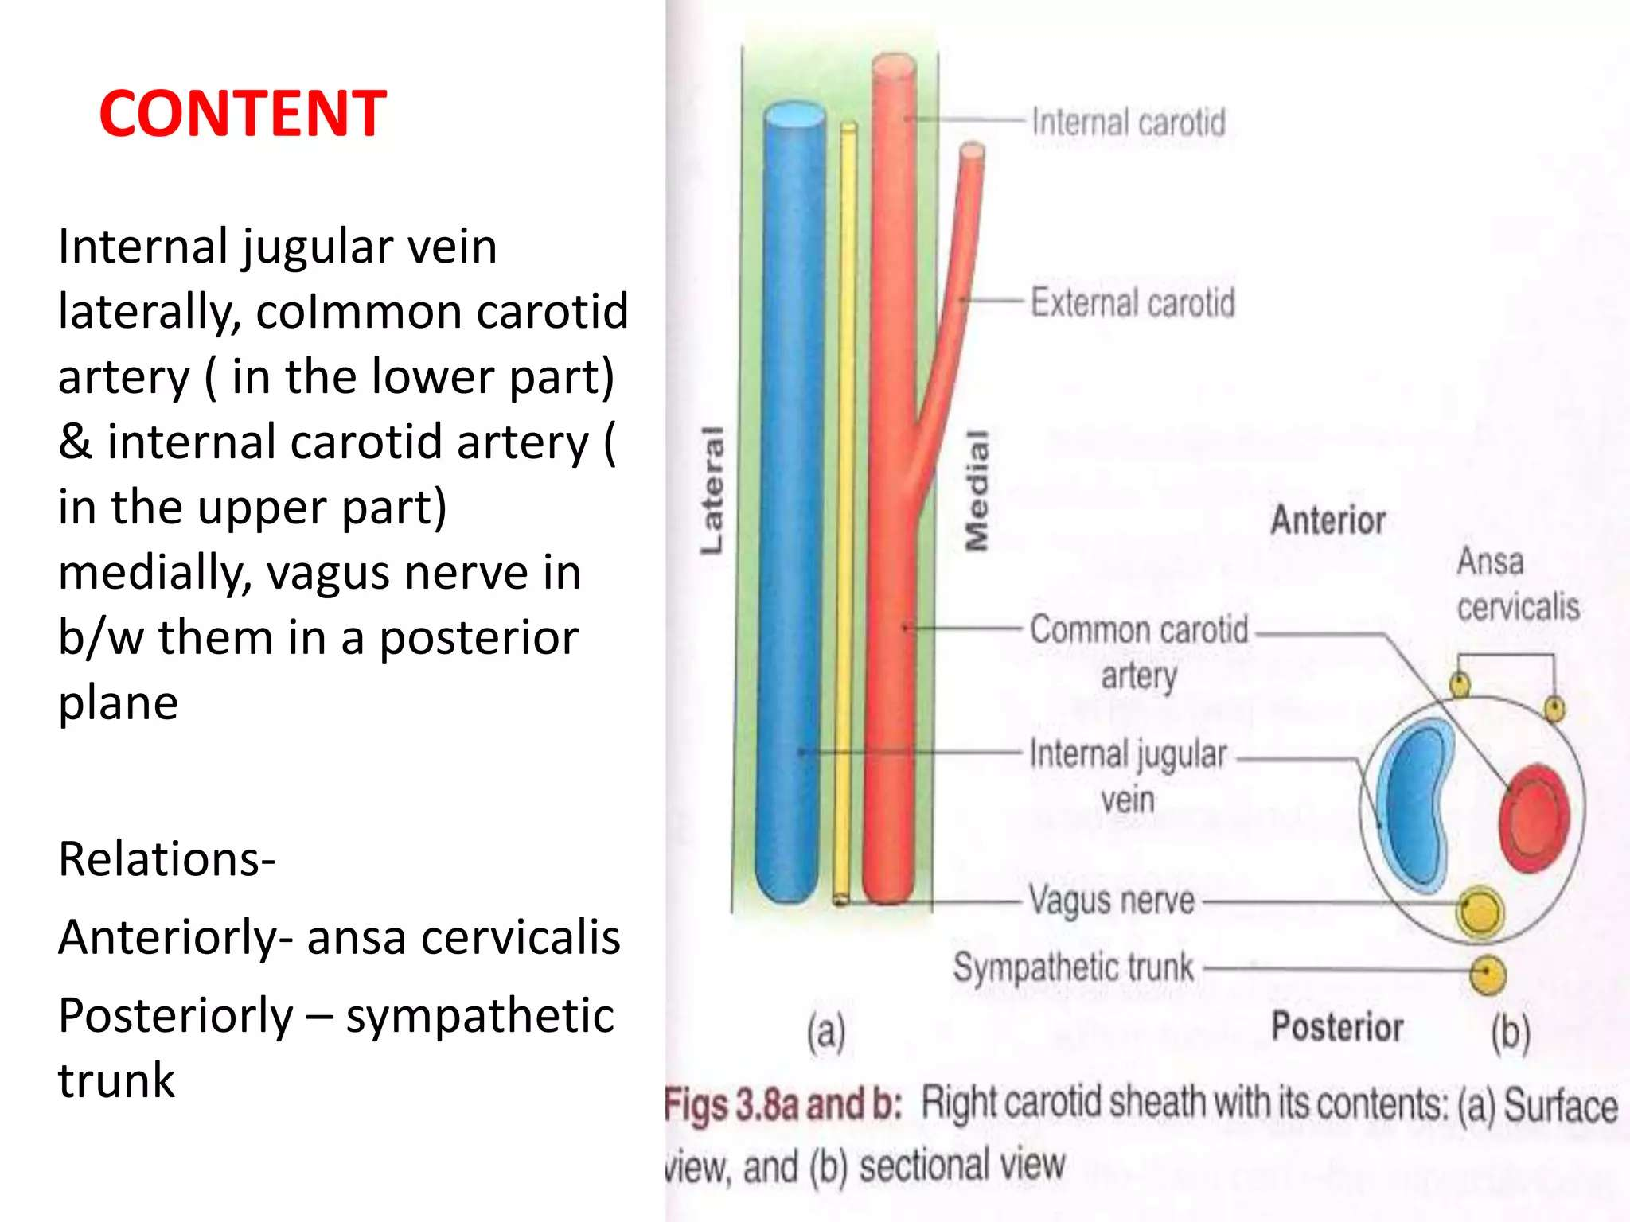

Slide 32
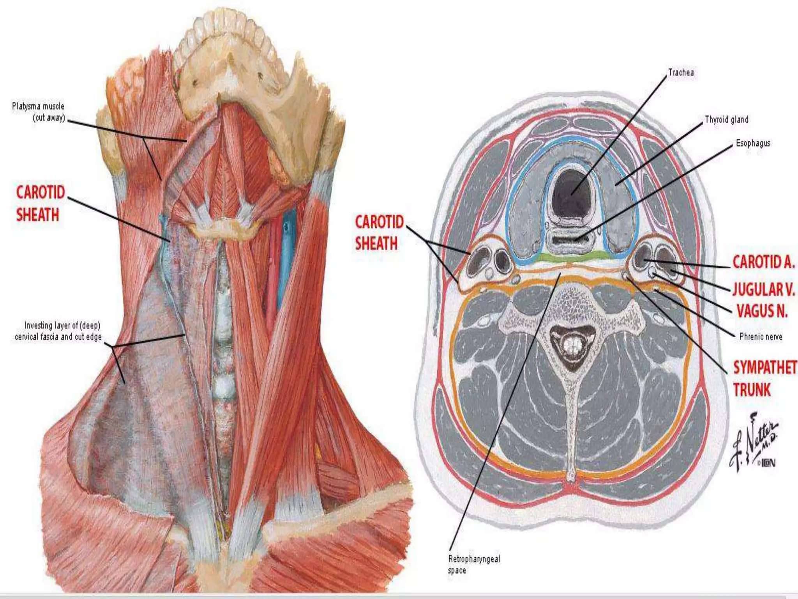

Slide 33
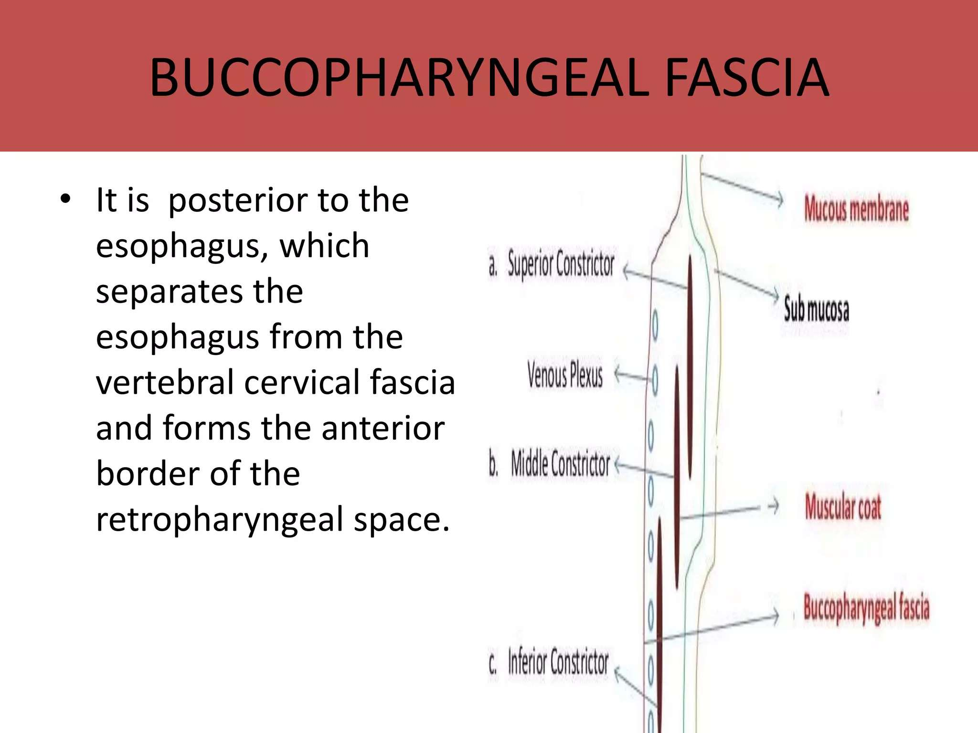

Slide 34
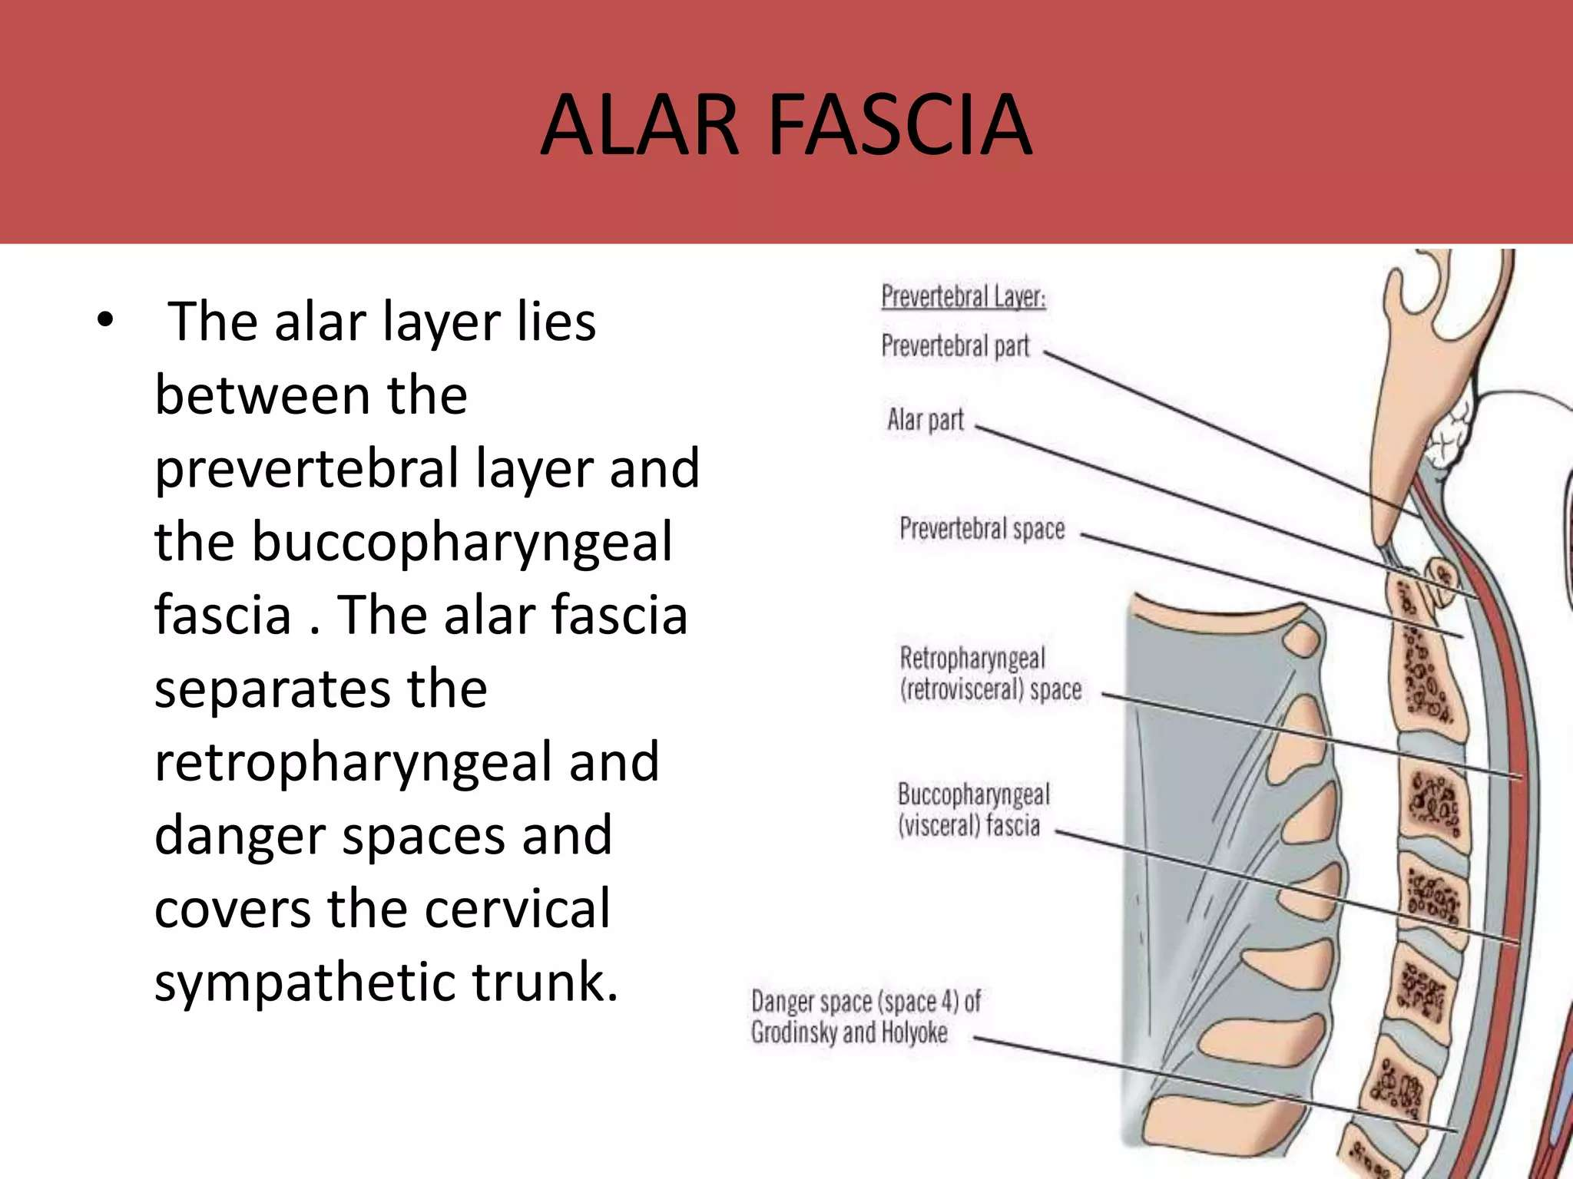

Slide 35
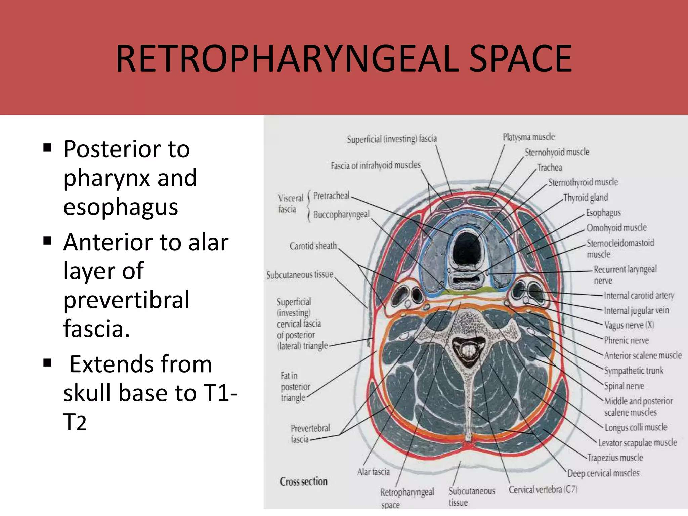

Slide 36
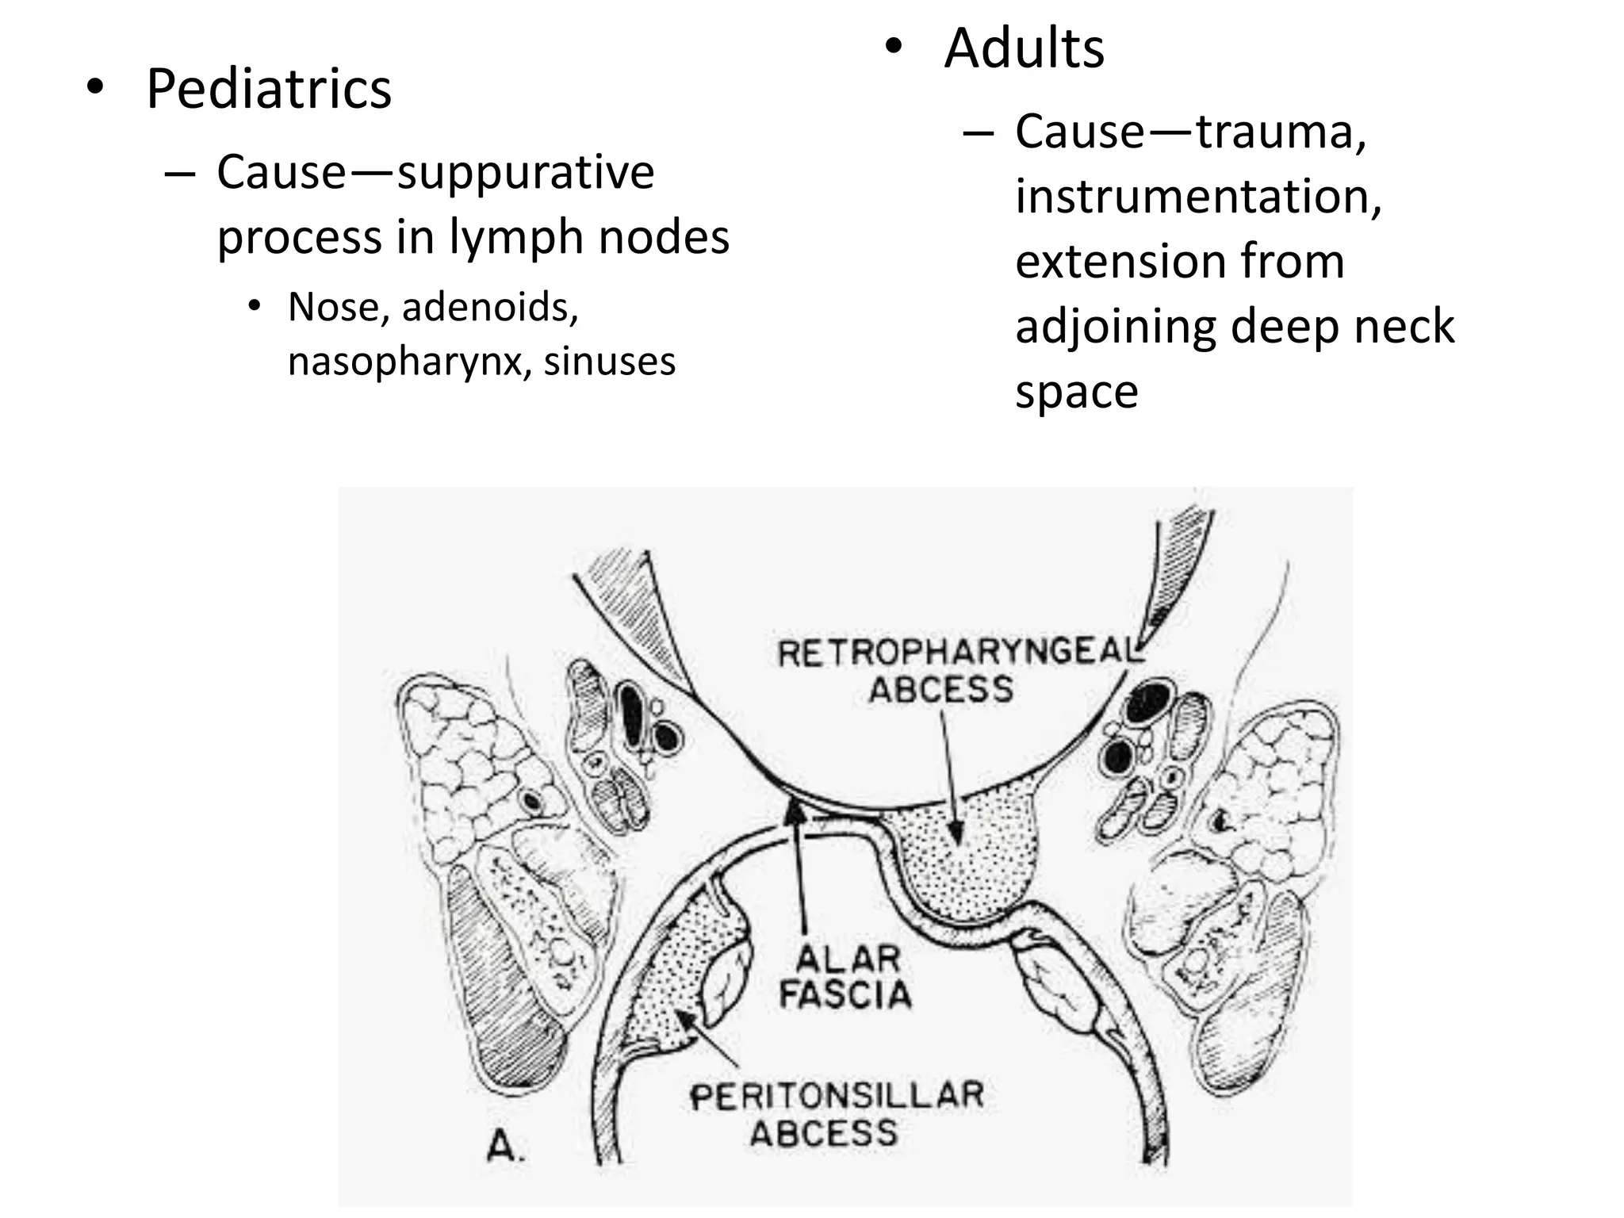

Slide 37
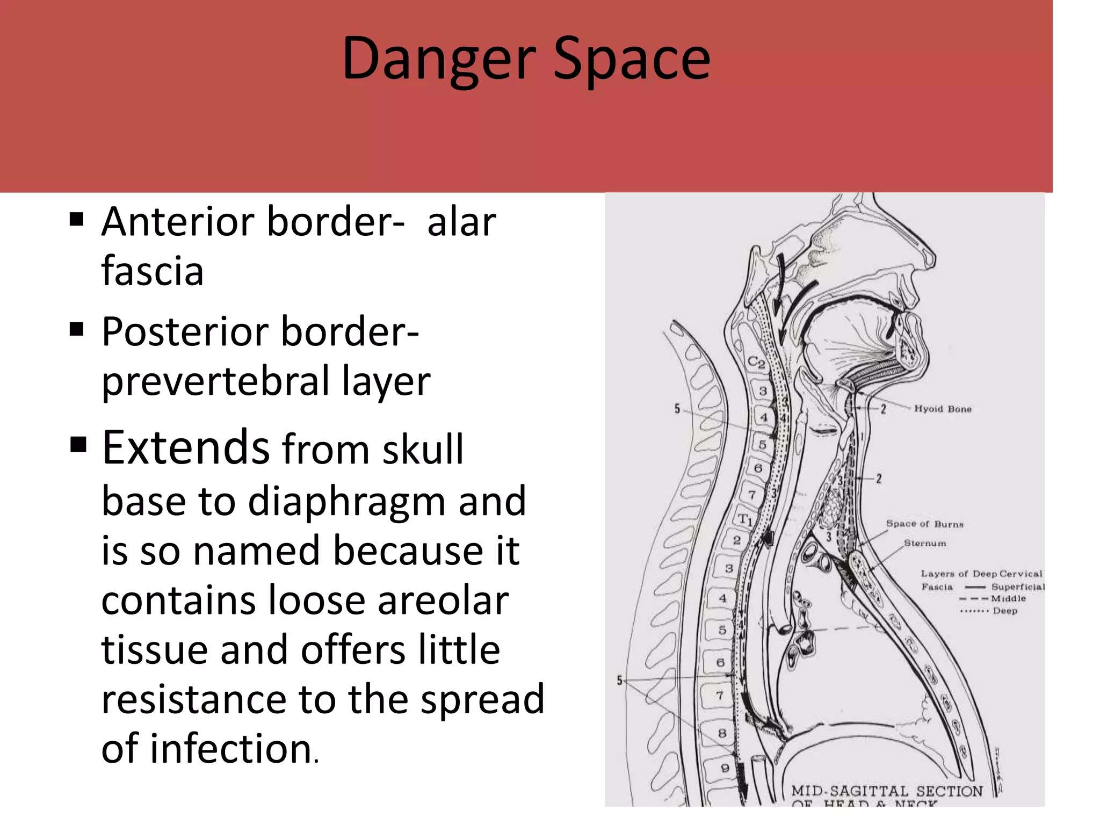

Slide 38
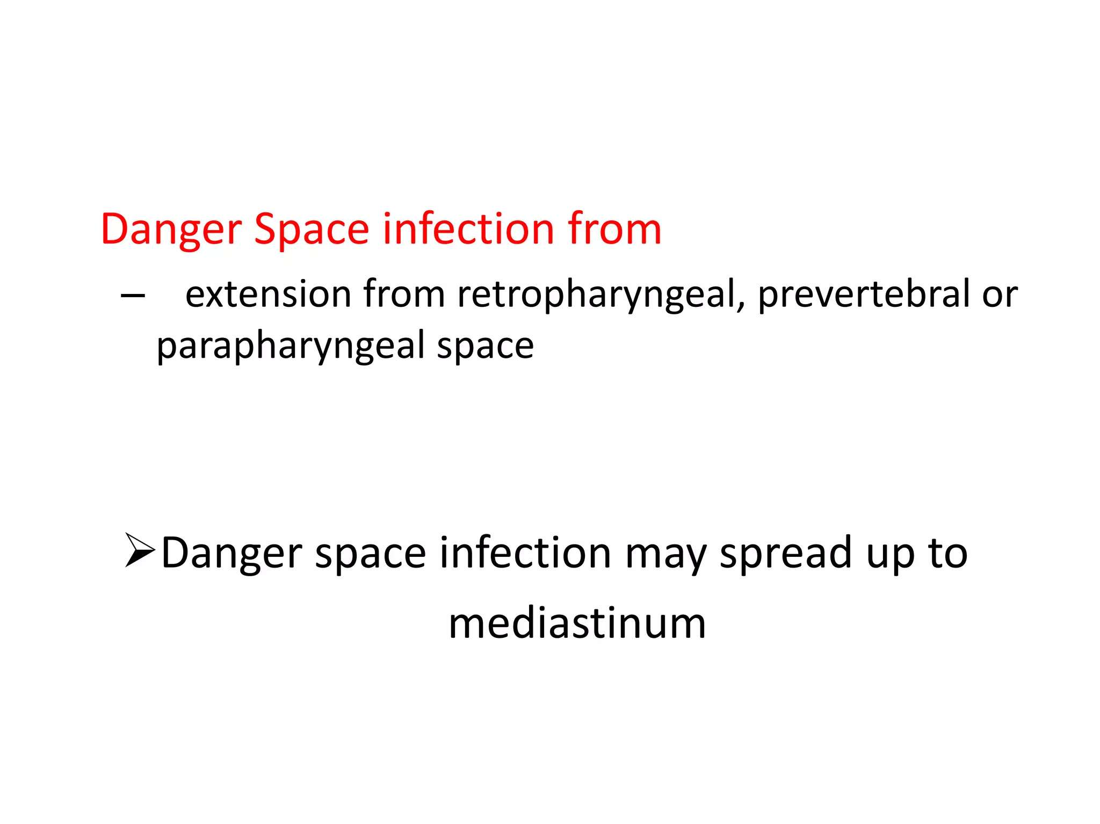

Slide 39
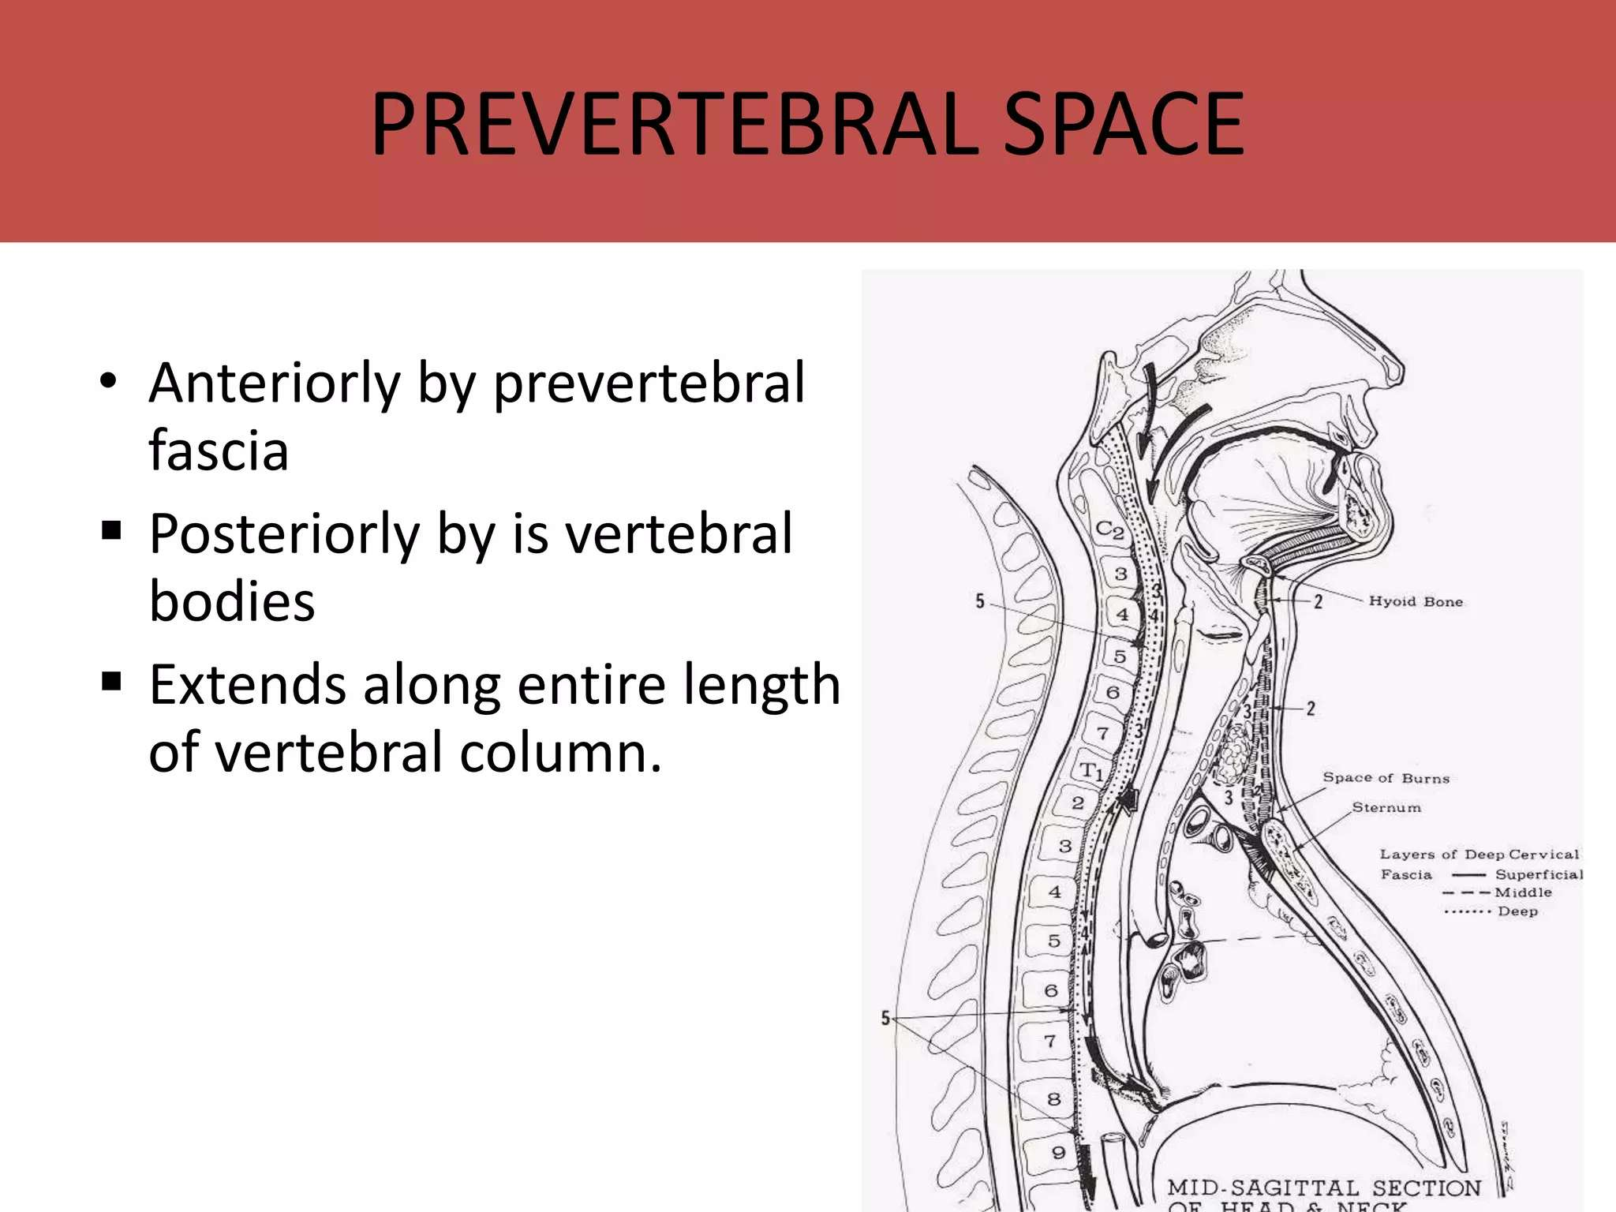

Slide 40
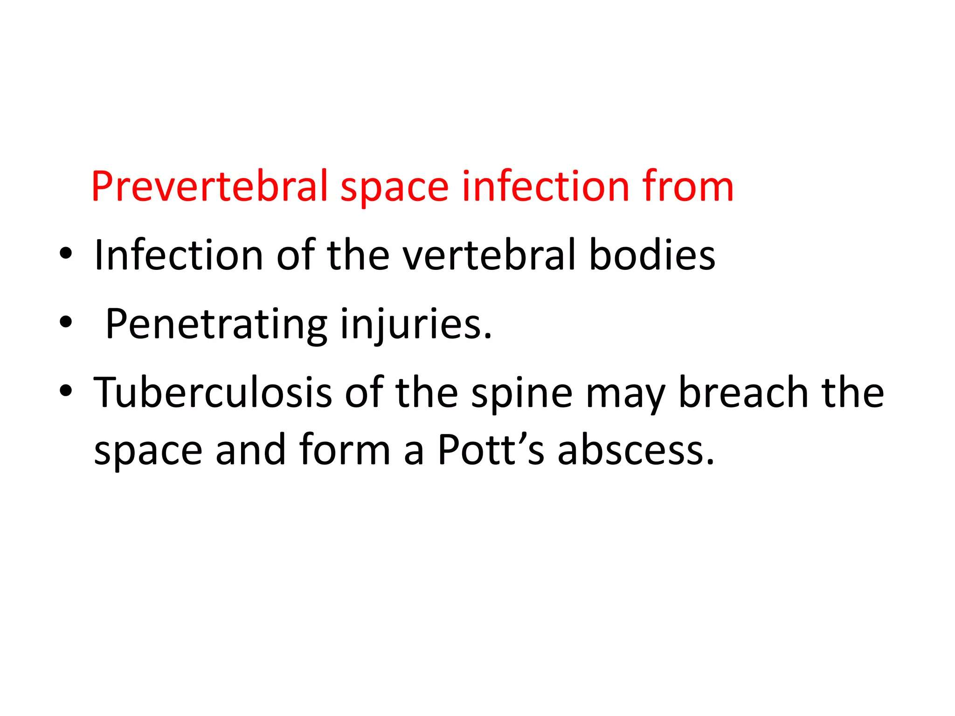

Slide 41
THANK YOU

